Slide 1
Gene Set Analysis
HUGEN 2073
Jon Chernus

Slide 2
How can you interpret a list of genes?
We’ve discussed a variety of types of annotation and tools for annotating association results at the variant level.
We’ve also discussed some ways of using annotation to “map” association results to particular genes.
Why not just publish the list of genes?

Slide 3
How can you interpret a list of genes?
Suppose your GWAS (or, say, differential expression study) has yielded a list of dozens to a few hundred genes.
Discussion questions
Why not just publish a list of genes and stop there?
Are all of the genes necessarily involved in the phenotype?
What scientific/statistical question(s) can you ask about a list of genes?

Slide 4
How can you interpret a list of genes?
Gene set analysis (or “enrichment analysis” or “over-representation analysis” or “pathway analysis”, although these are not exactly synonymous) ask questions like “are certain categories of genes over-represented in my results, compared to what would be expected by chance?”
It’s important to consider exactly what a null hypothesis tests in gene set analysis – it can be quite nuanced.
Gene set analysis originated in the context of differential expression studies, which can yield lists of genes whose expression is up- or down-regulated for one trait/cell type vs. another.
Some methods can incorporate GWAS summary statistics or gene-based measures of association with a phenotype.

Slide 5
Flavors of gene set analysis
One way to conceptually grouping gene set analysis techniques is to divide them into “self-contained” and “competitive” methods. A variety of methods exist.
“Self-contained” uses only the list of genes that have been culled from the whole genome by some kind of prioritization (e.g., gene-mapping)
“Competitive” uses all the genes you have association statistics for

Slide 6
Over-representation/enrichment
When asking what categories of genes are over-represented among a prioritized list of genes, what kinds of categories exist?
What kinds of categories might you be interested in? (Discuss)

Slide 7
Over-representation
Example: a GWAS of telomere length https://www.medrxiv.org/content/10.1101/2021.03.23.21253516v1
Key components of telomere regulatory complexes found within genome-wide significant loci.
Proteins depicted in green are found within GWAS loci, those not found within GWAS loci are depicted in blue.
We find the majority of components of core telomere binding complexes alongside many proteins involved in the formation and activity of telomerase. Note that not all components of the RNA exosome are shown.

Slide 8
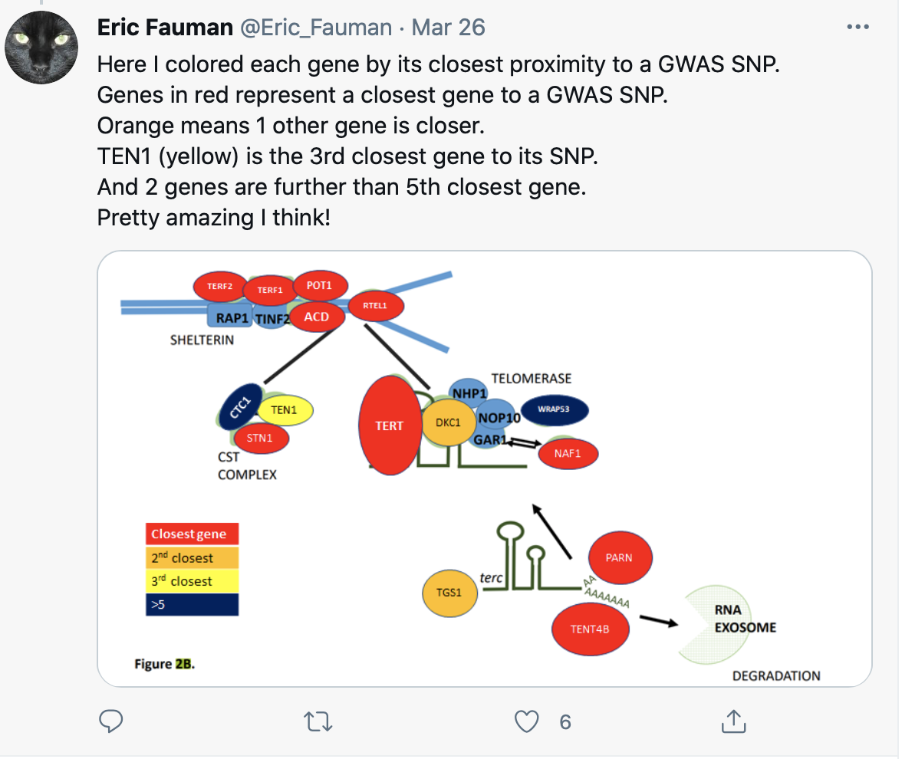
Over-representation
It looks like “telomerase-maintenance” genes are probably over-represented in these GWAS results.
(In a GWAS of telomere length, this is not surprising.)
But how to quantify the over-representation?

Slide 9
Some examples of gene sets/databases/tools
Gene Ontologies (GO) (http://geneontology.org)
PANTHER (http://www.pantherdb.org)
KEGG (https://www.genome.jp/kegg/)
IPA (https://digitalinsights.qiagen.com/products-overview/discovery-insights-portfolio/analysis-and-visualization/qiagen-ipa/; not free)
Pathway Commons (https://www.pathwaycommons.org)
Reactome (https://reactome.org)
GREAT (http://great.stanford.edu/public/html/)
GSEA (https://www.gsea-msigdb.org/gsea/index.jsp)
DAVID (https://david.ncifcrf.gov)
MAGMA (https://ctg.cncr.nl/software/magma)
FUMA (GENE2FUNC function; MAGMA) (https://fuma.ctglab.nl)
Enrichr (https://maayanlab.cloud/Enrichr/)

Slide 10
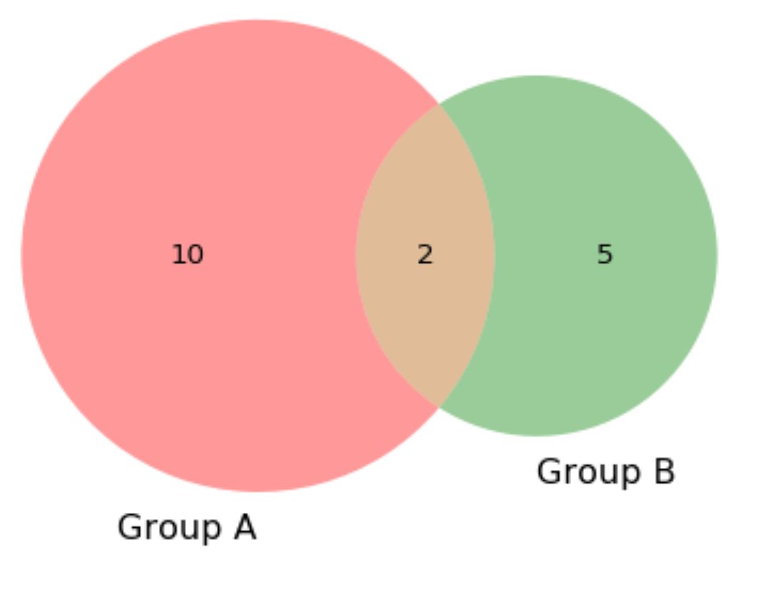
The simplest over-representation test
Venn diagram to show enrichment
Input gene set
Reference gene set

Slide 11
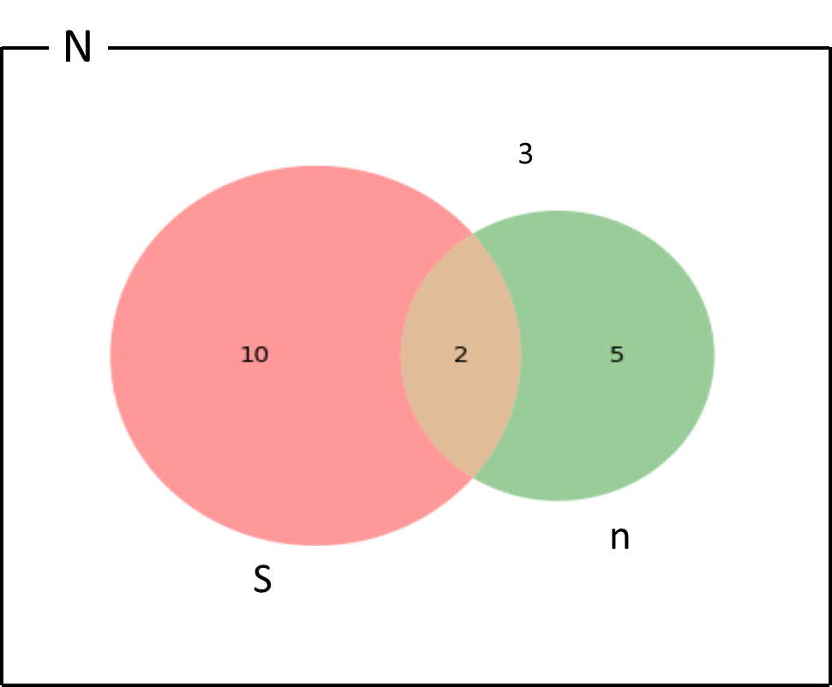
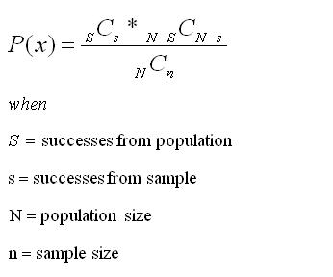



Hypergeometric test to estimate significance of overlap (Fisher’s test)
Definition:
_{a}$Cb=\left({a \atop b}\right)= \frac{a!}{\left(a−b\right)!(b!)}$
= size of gene set = 12
$Phypergeometric=$ P( see overlap at least this big)
= $\sum_{i=x}^{n}{P(i)}$
= overlap of your genes with gene set = 2
= total number of genes “out there” = 20
= genes from your analysis = 7
Experiment
Draw n observations without replacement from a total population of size N
S out of N are “successes”
What’s the probability of drawing exactly s of the S “successes” in your sample of size n?
Or, what’s the probability of exactly this much overlap between your sample and the “success” set, S $⊆$ N?
To estimate significance of the overlap, we need to know the size of the “universe”/population (N)!

Slide 12
Gene Ontologies
http://geneontology.org
Gene ontology (GO) is a formalized system for categorizing/annotating genes according to their biological functions.
This makes it easier to systematically compare gene sets and also can help keep track of similar genes across different organisms.
Every gene has assigned three “aspects”
Molecular function
Cellular component
Biological process

Slide 13
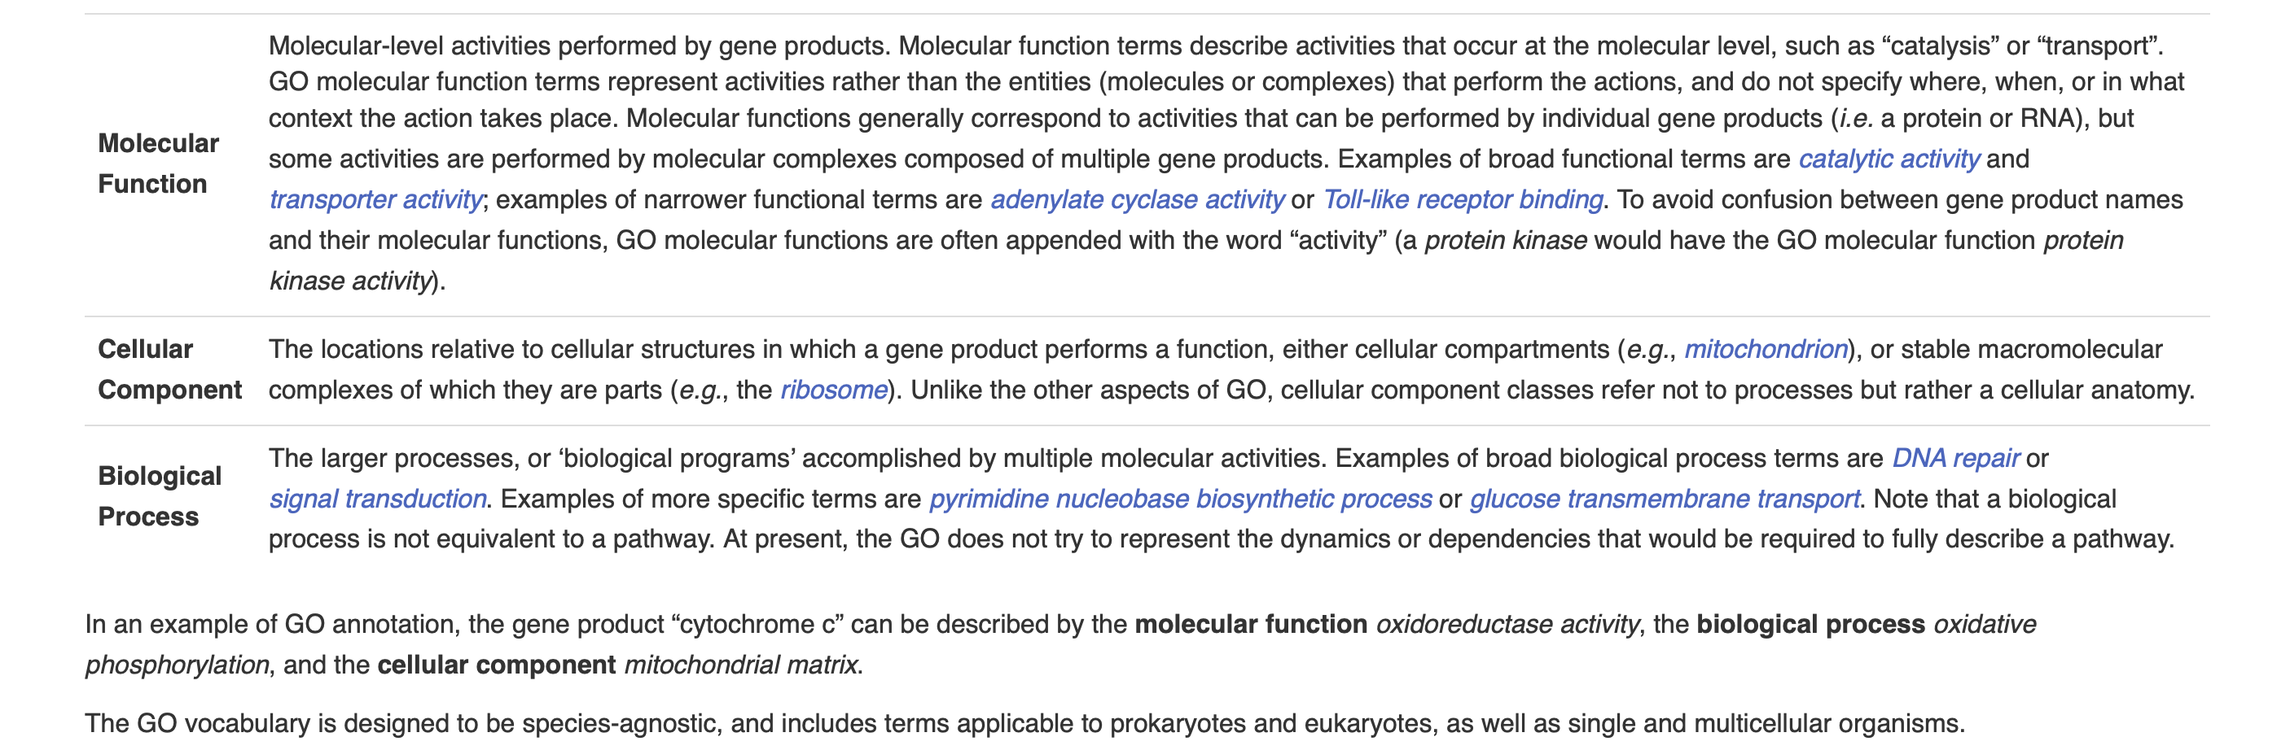
Gene Ontologies - aspects

Slide 14
Gene Ontologies – GO terms
Each possible aspect is arranged in a hierarchy or “tree” ranging from the most general to the most specific.
If a gene belong to a specific class, it also belongs to call of the “parent” classes in the hierarchy containing that class.
The entire system of classes can be described with a formalized logical vocabulary.

Slide 15
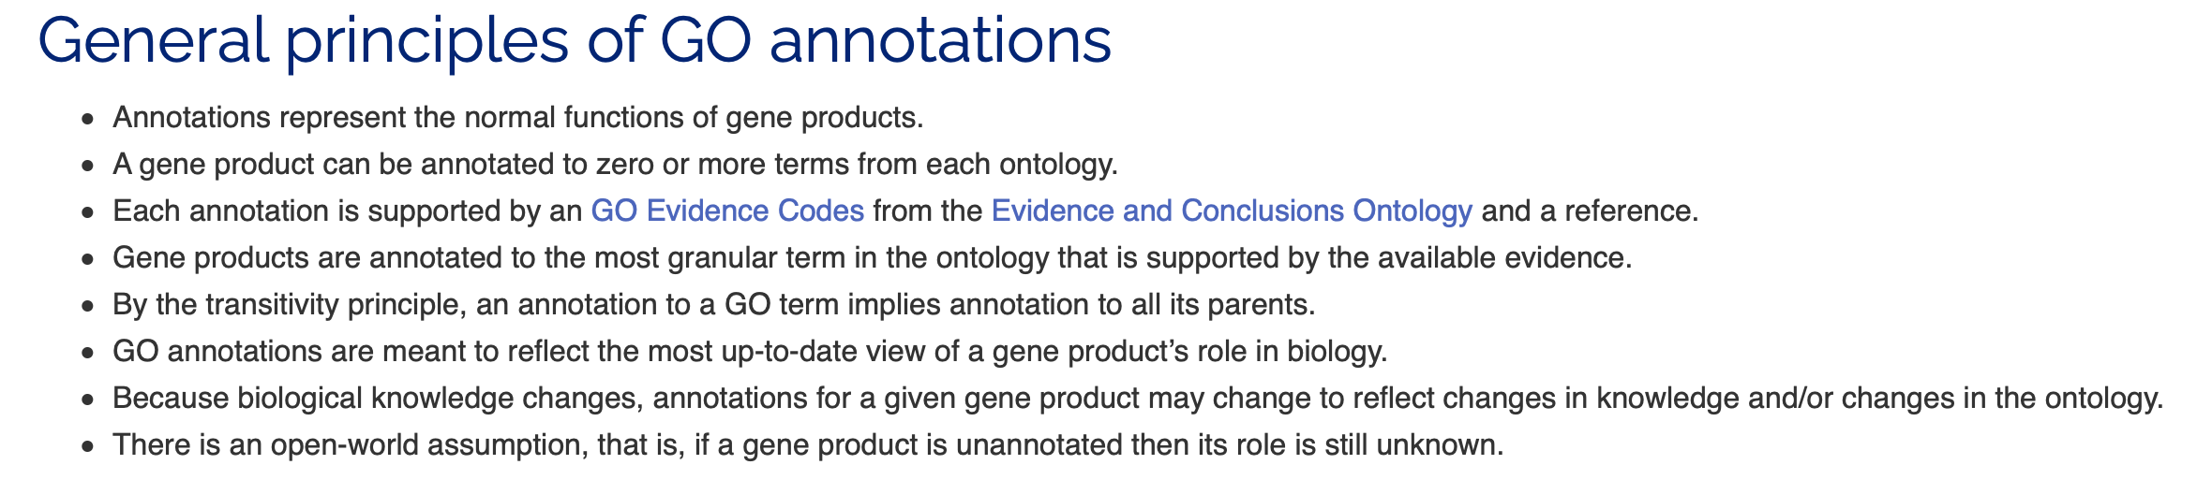
Gene Ontologies – GO terms

Slide 16
Gene Ontologies – GO terms
The possible values for a given aspect are called GO terms or classes and have unique identifiers and descriptions:

Slide 17
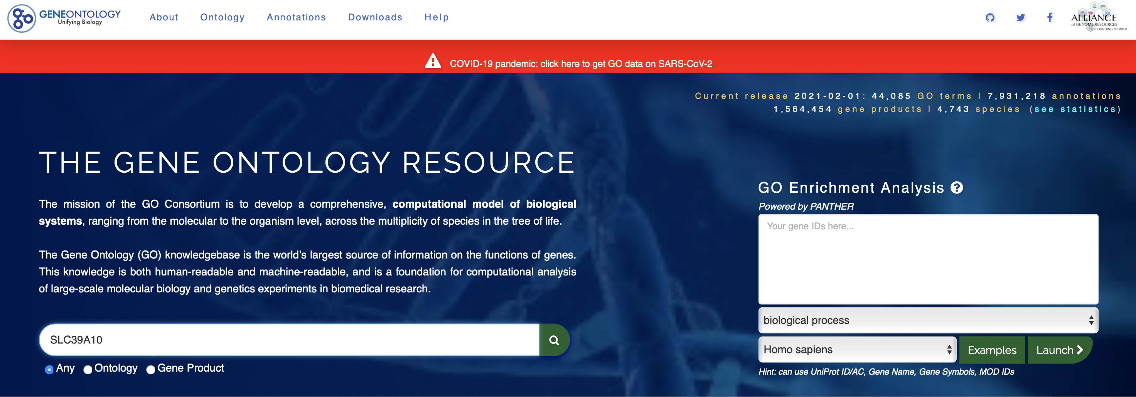
Gene Ontologies
Searching a gene

Slide 18
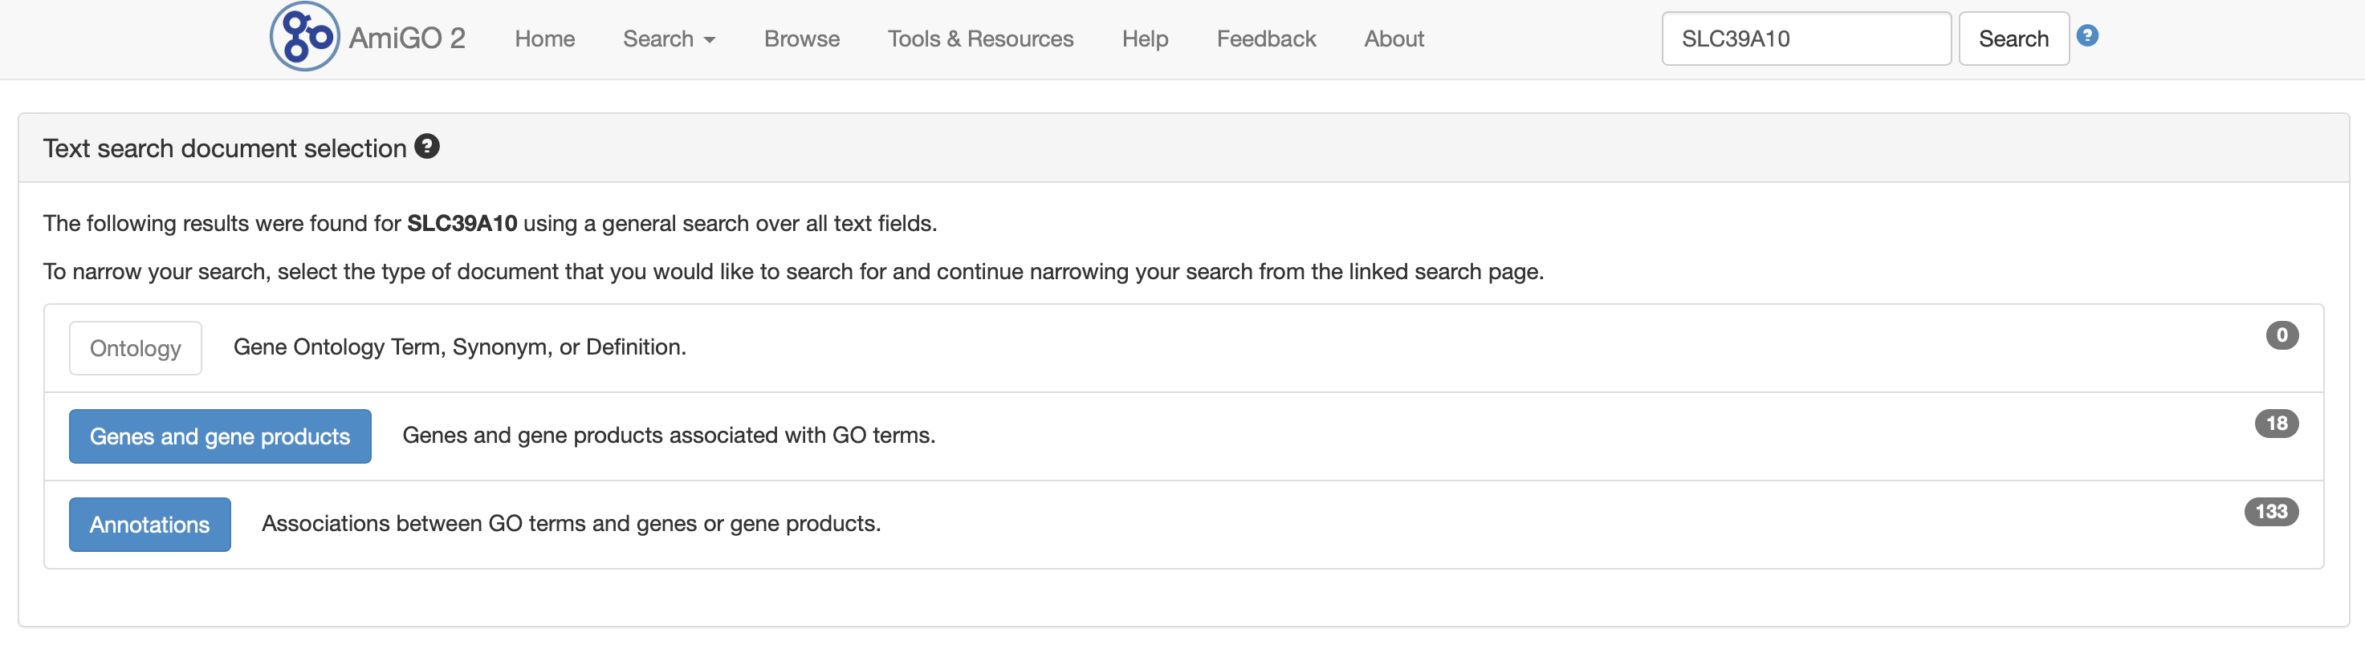
Gene Ontologies
Search results. Let’s click on “genes and gene products.”

Slide 19
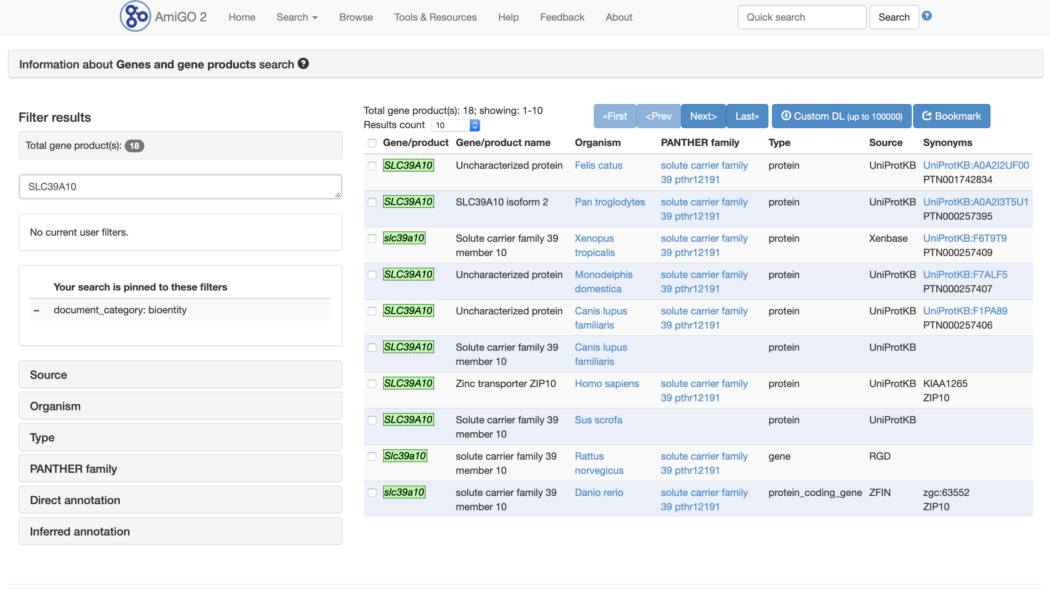
Gene Ontologies
Let’s select Homo sapiens.

Slide 20
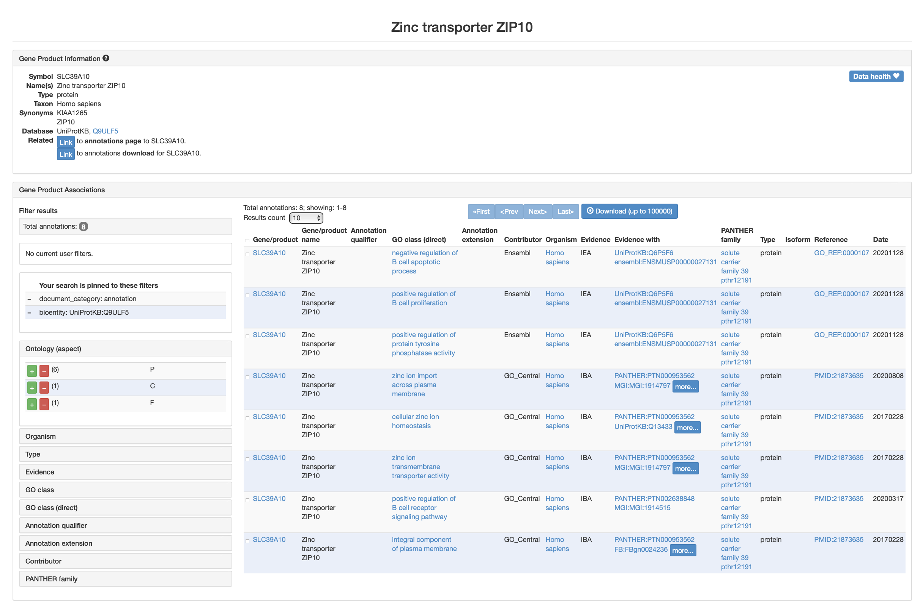
Gene Ontologies
Results for SLC39A10

Slide 21
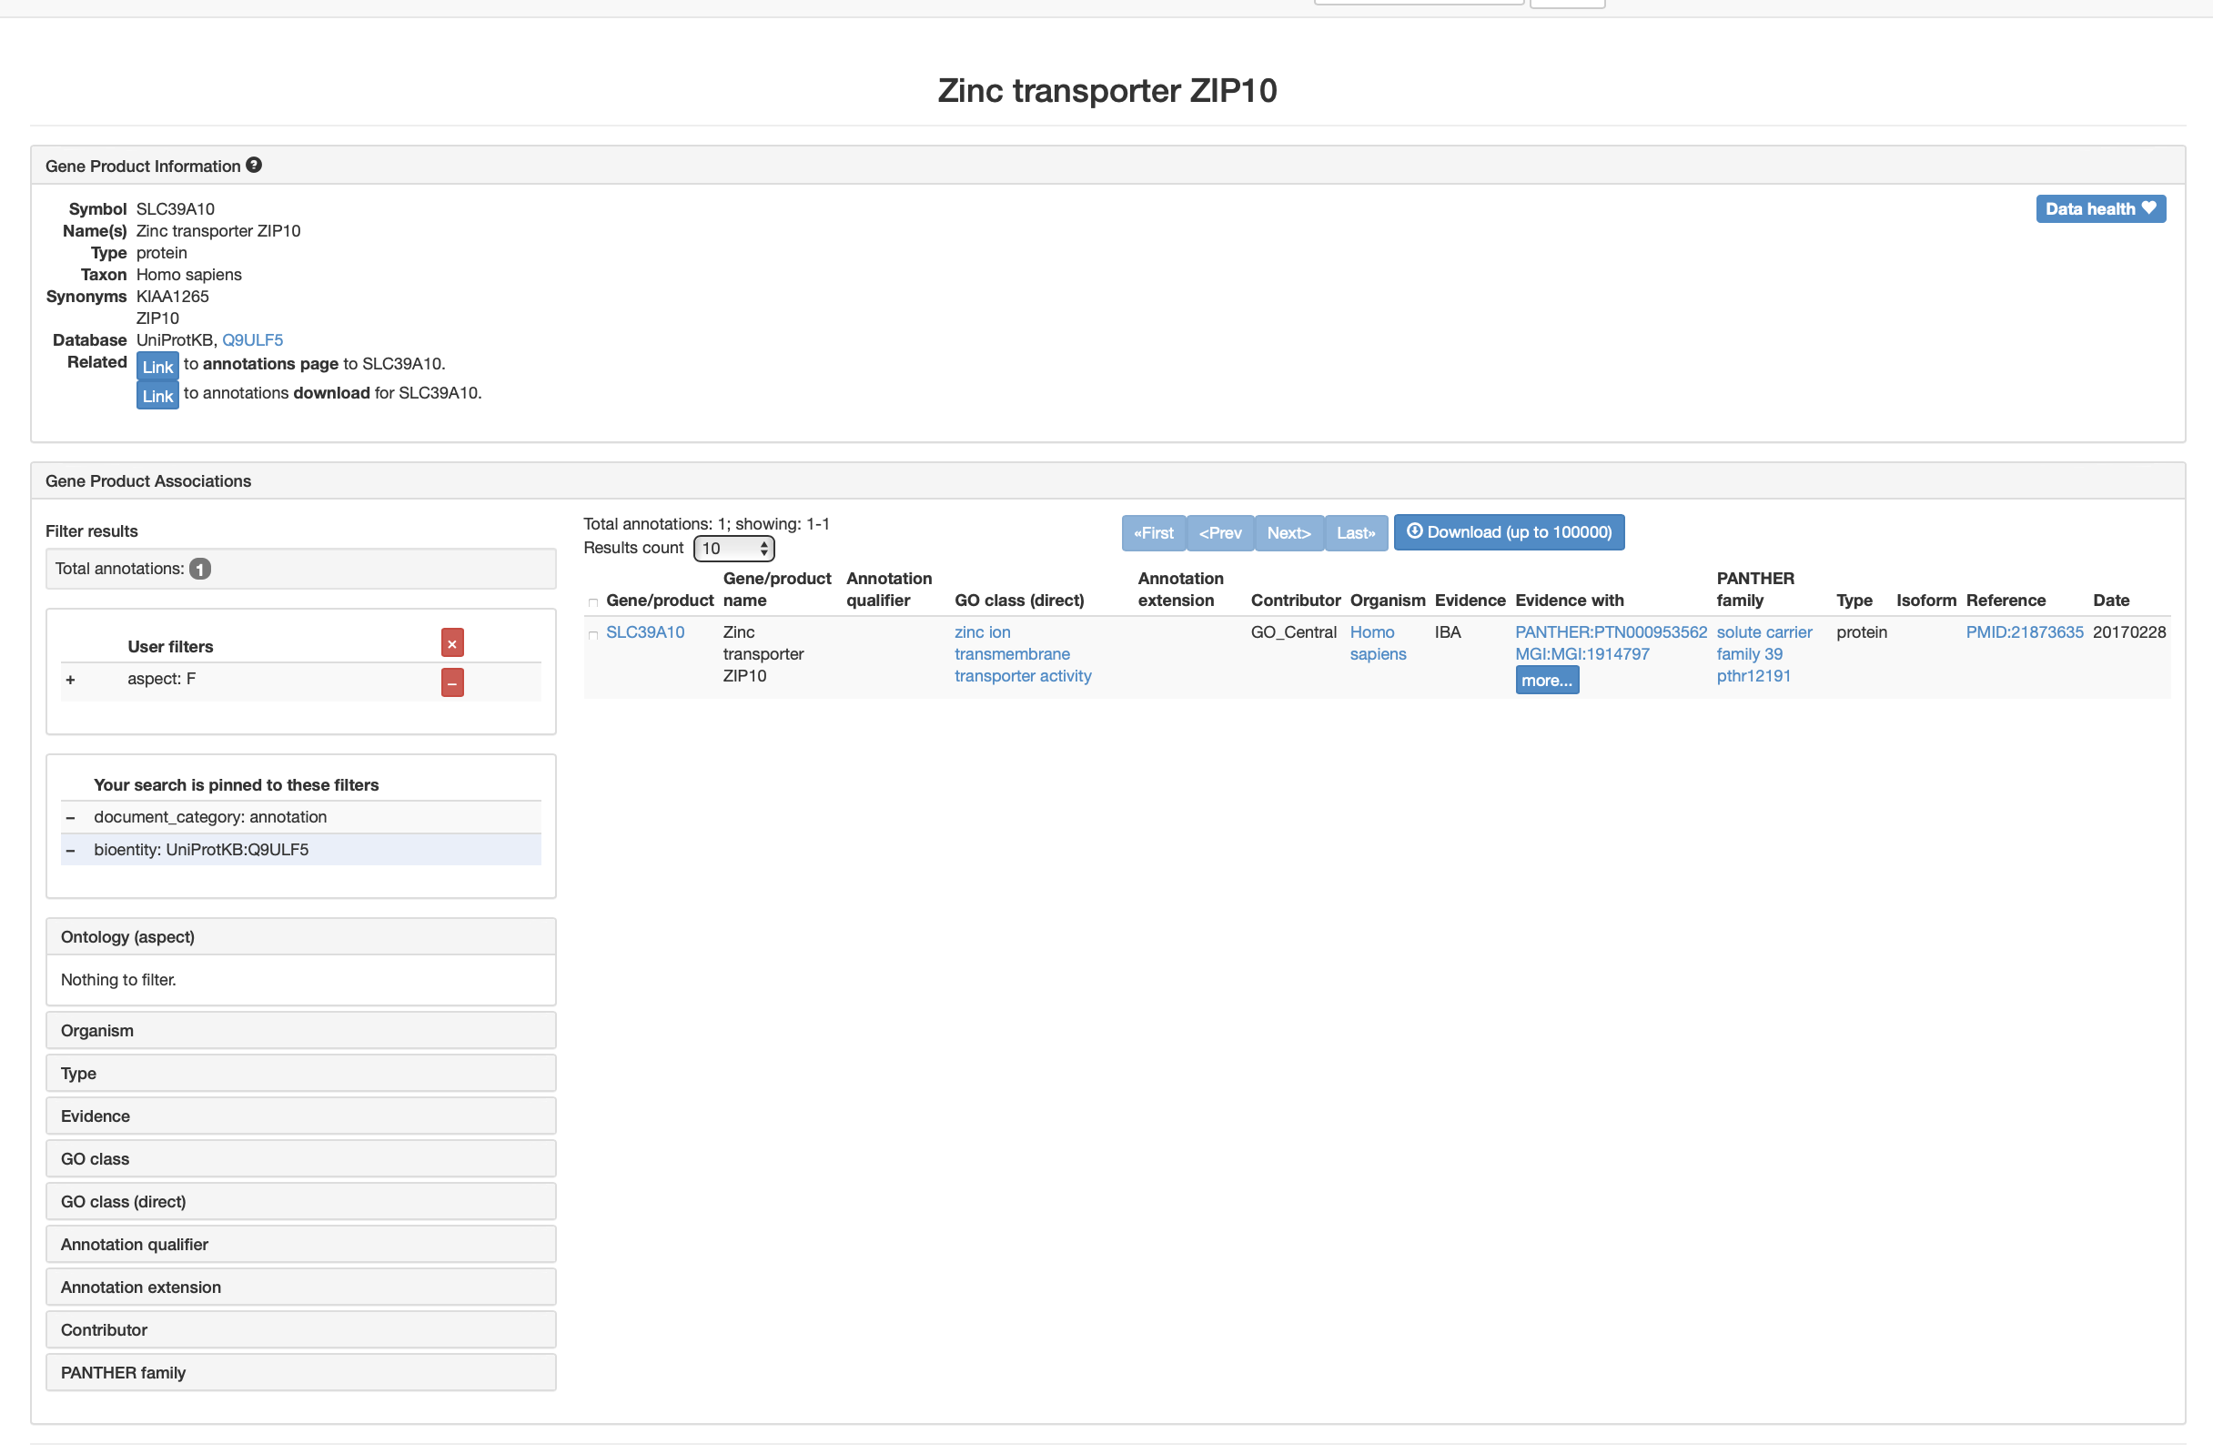
Gene Ontologies
Results for SLC39A10. Filter to show only aspect F (function)

Slide 22
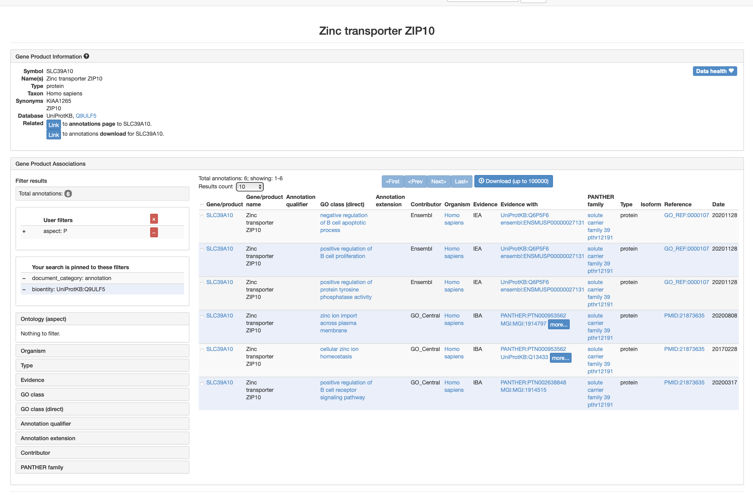
Gene Ontologies
Results for SLC39A10. Filter to show only aspect P (process)

Slide 23
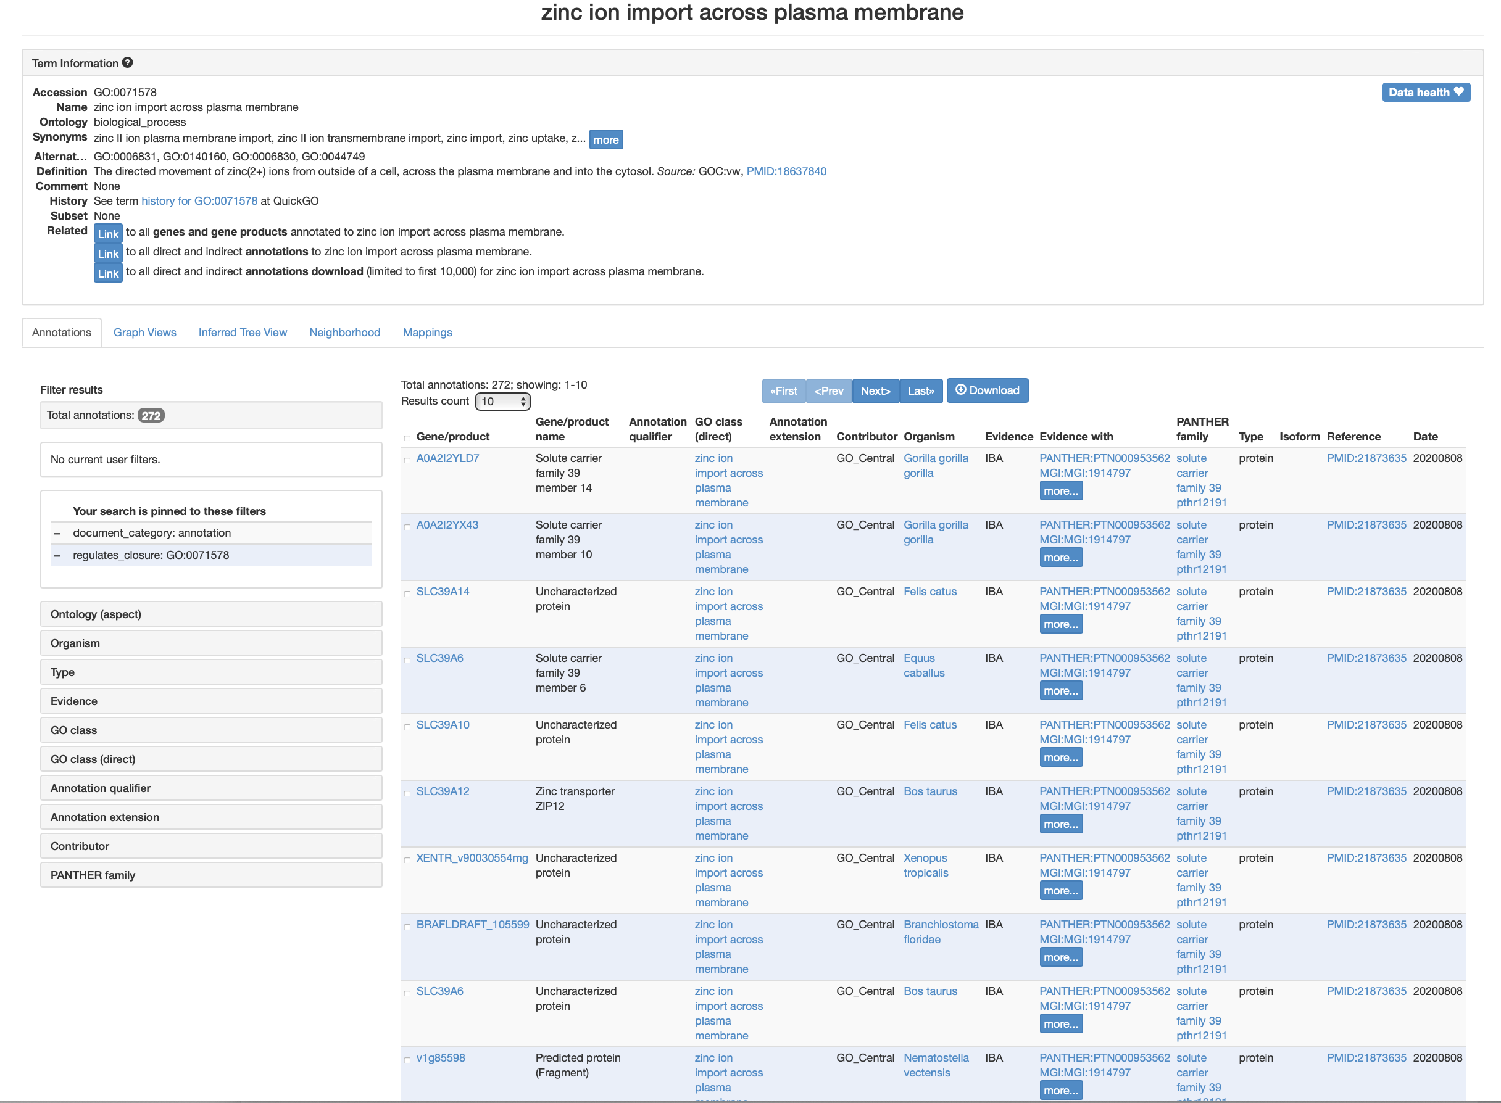
Gene Ontologies
Result of clicking on one of the GO terms: “zinc ion import across plasma membrane.”

Slide 24
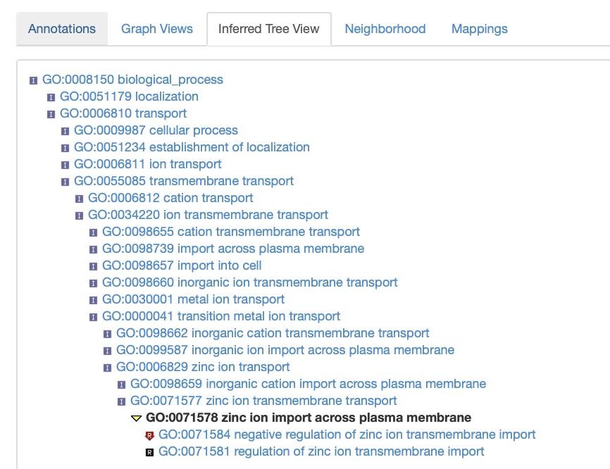
Gene Ontologies
Result of clicking on “Inferred Tree View”

Slide 25
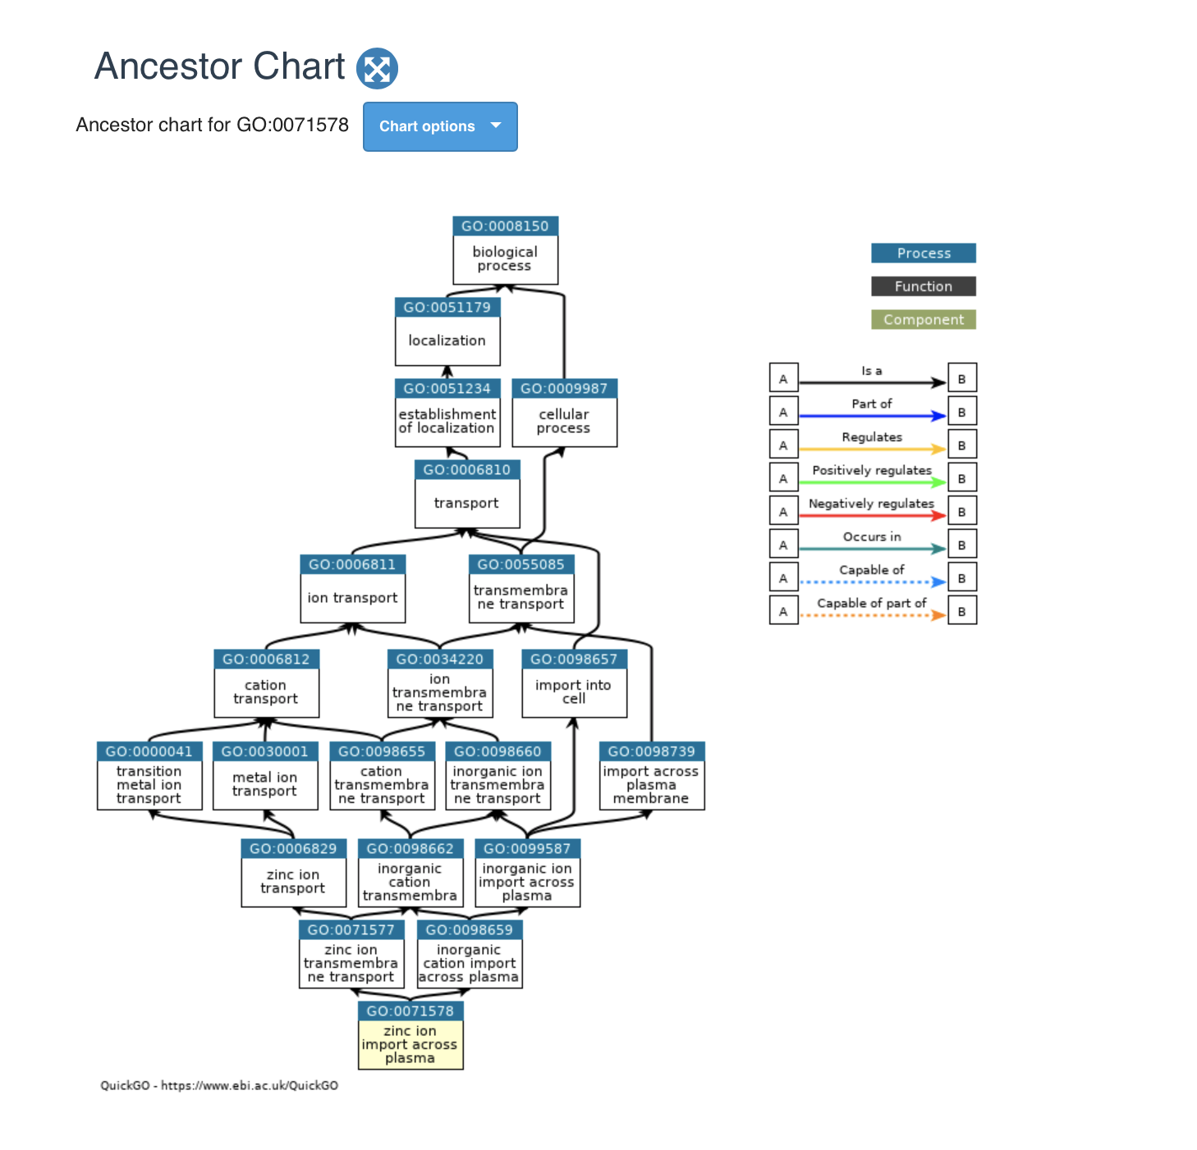
Gene Ontologies
An option from “Graph Views”

Slide 26
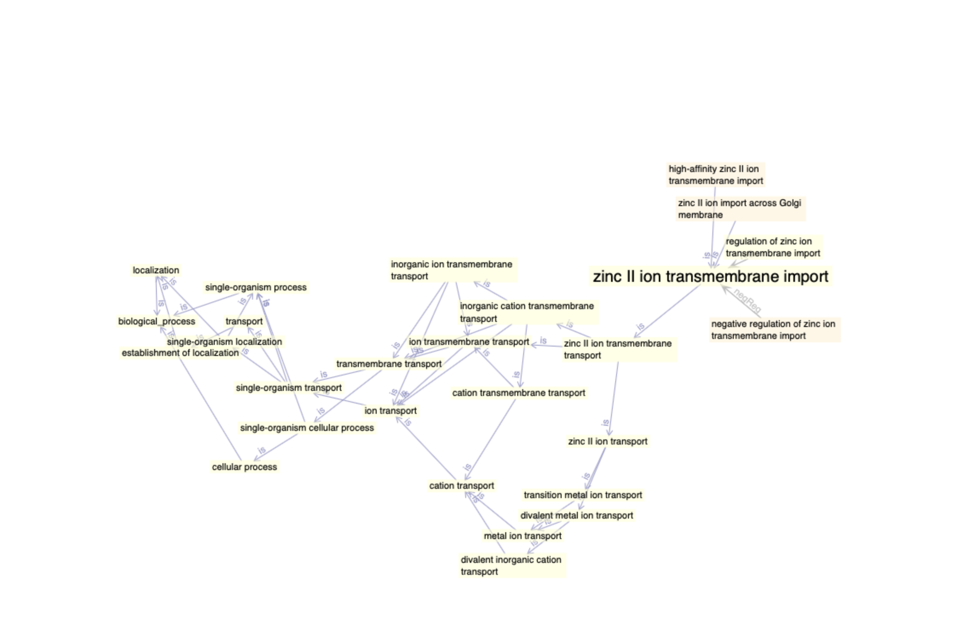
Gene Ontologies
Another option from “Graph Views”

Slide 27
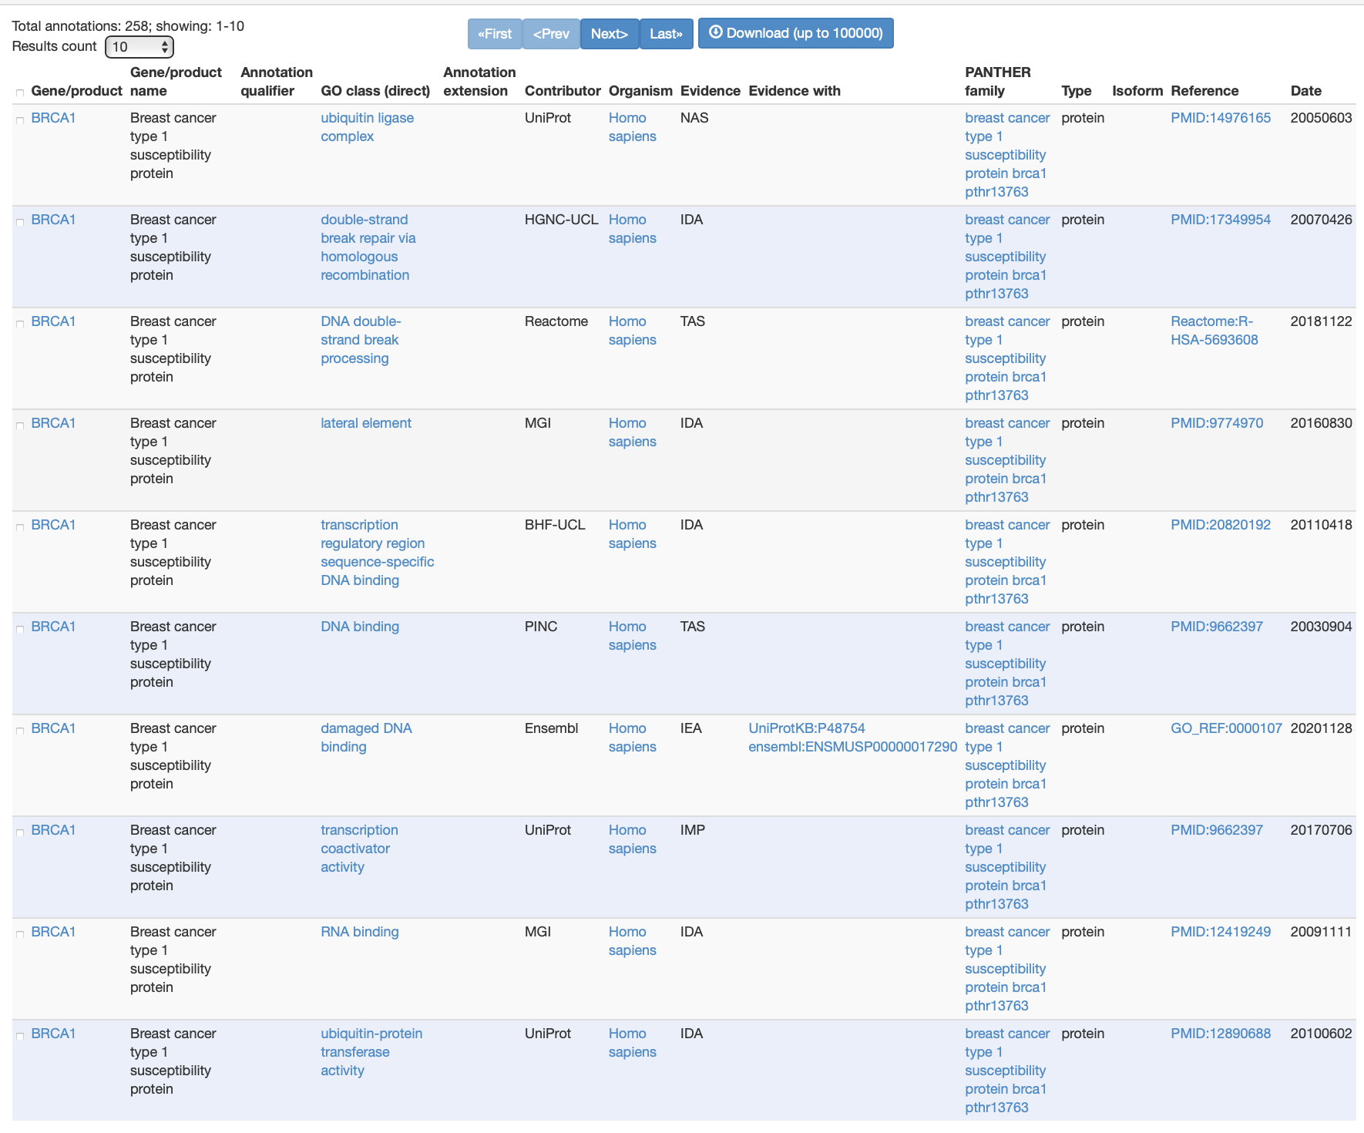
Gene Ontologies – sources and evidence

Slide 28
Experimental Evidence evidence codes: Inferred from Experiment (EXP) Inferred from Direct Assay (IDA) Inferred from Physical Interaction (IPI) Inferred from Mutant Phenotype (IMP) Inferred from Genetic Interaction (IGI) Inferred from Expression Pattern (IEP)
Notes:
This text slide was borrowed from Frank Fan’s presentation.

Slide 29
Computational Analysis evidence codes: Inferred from Sequence or structural Similarity (ISS) Inferred from Sequence Orthology (ISO) Inferred from Sequence Alignment (ISA) Inferred from Sequence Model (ISM) Inferred from Genomic Context (IGC) Inferred from Biological aspect of Ancestor (IBA) Inferred from Biological aspect of Descendant (IBD) Inferred from Key Residues (IKR) Inferred from Rapid Divergence (IRD) Inferred from Reviewed Computational Analysis (RCA)
Notes:
This text slide was borrowed from Frank Fan’s presentation.

Slide 30
Author Statement evidence codes: Traceable Author Statement (TAS) Non-traceable Author Statement (NAS) Curatorial Statement codes: Inferred by Curator (IC) No biological Data available (ND) evidence code Automatically-Assigned evidence code: Inferred from Electronic Annotation (IEA)
Notes:
This text slide was borrowed from Frank Fan’s presentation.

Slide 31
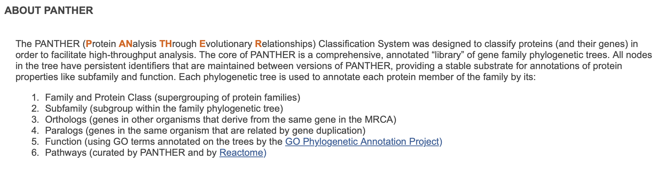
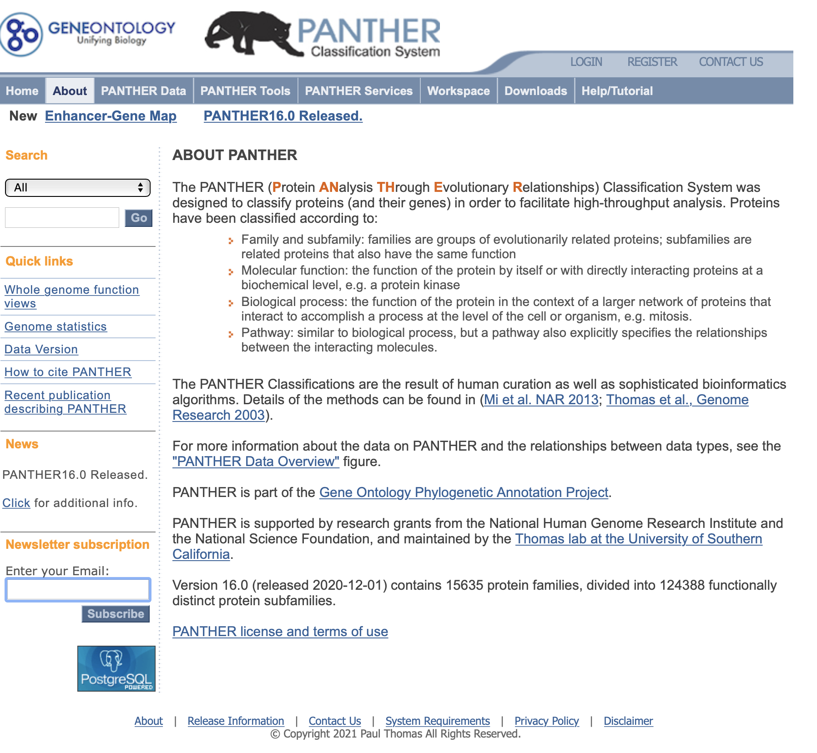
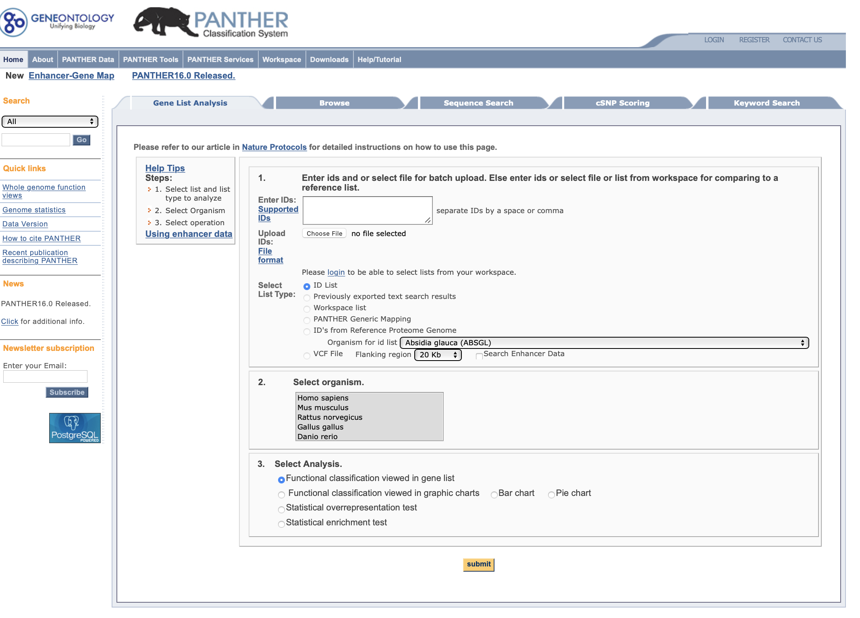
PANTHER
http://pantherdb.org

Slide 32
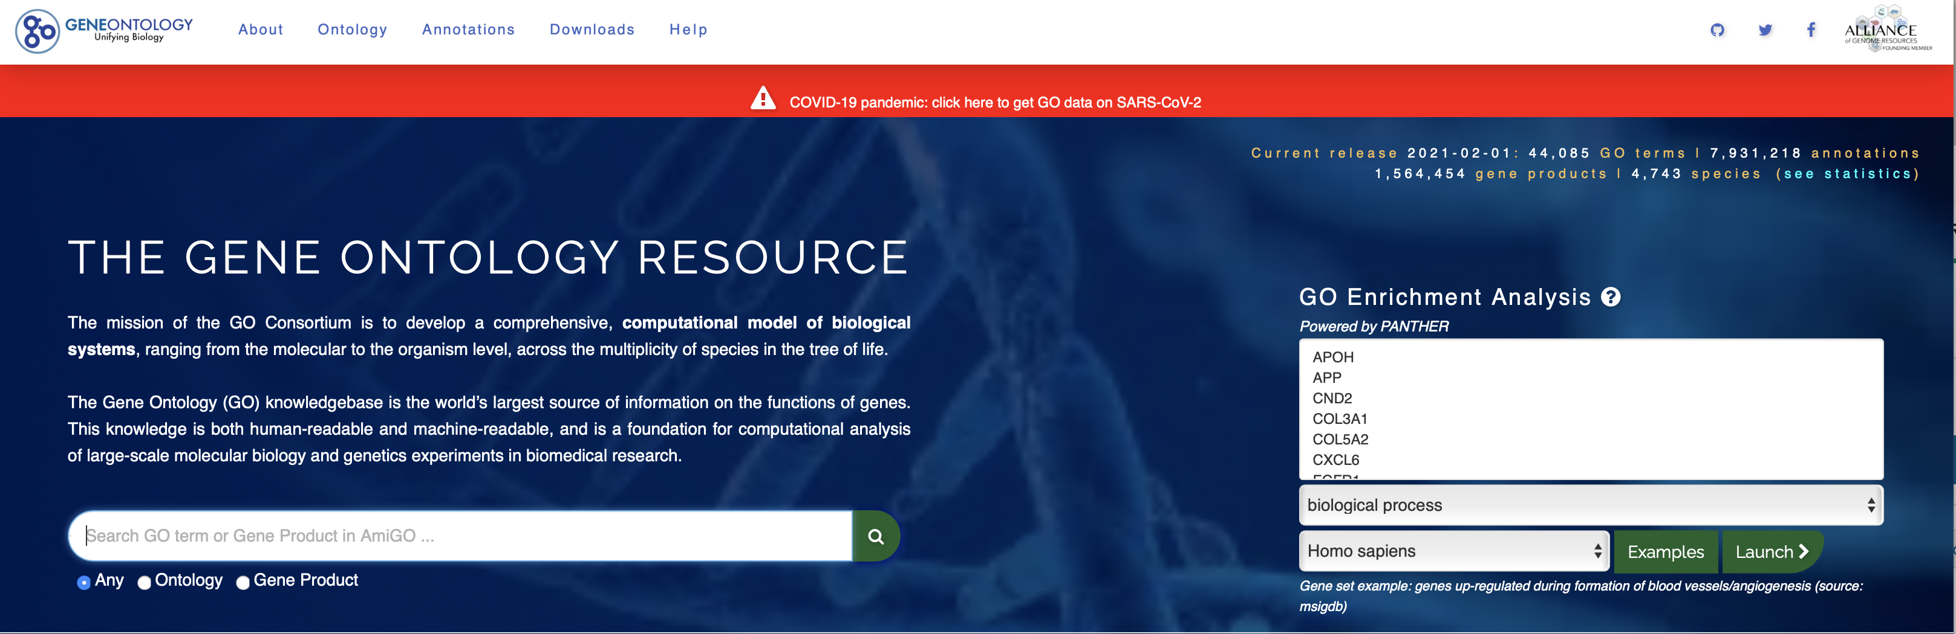
GO enrichment analysis (PANTHER)
Enter a list of genes and click Launch >

Slide 33
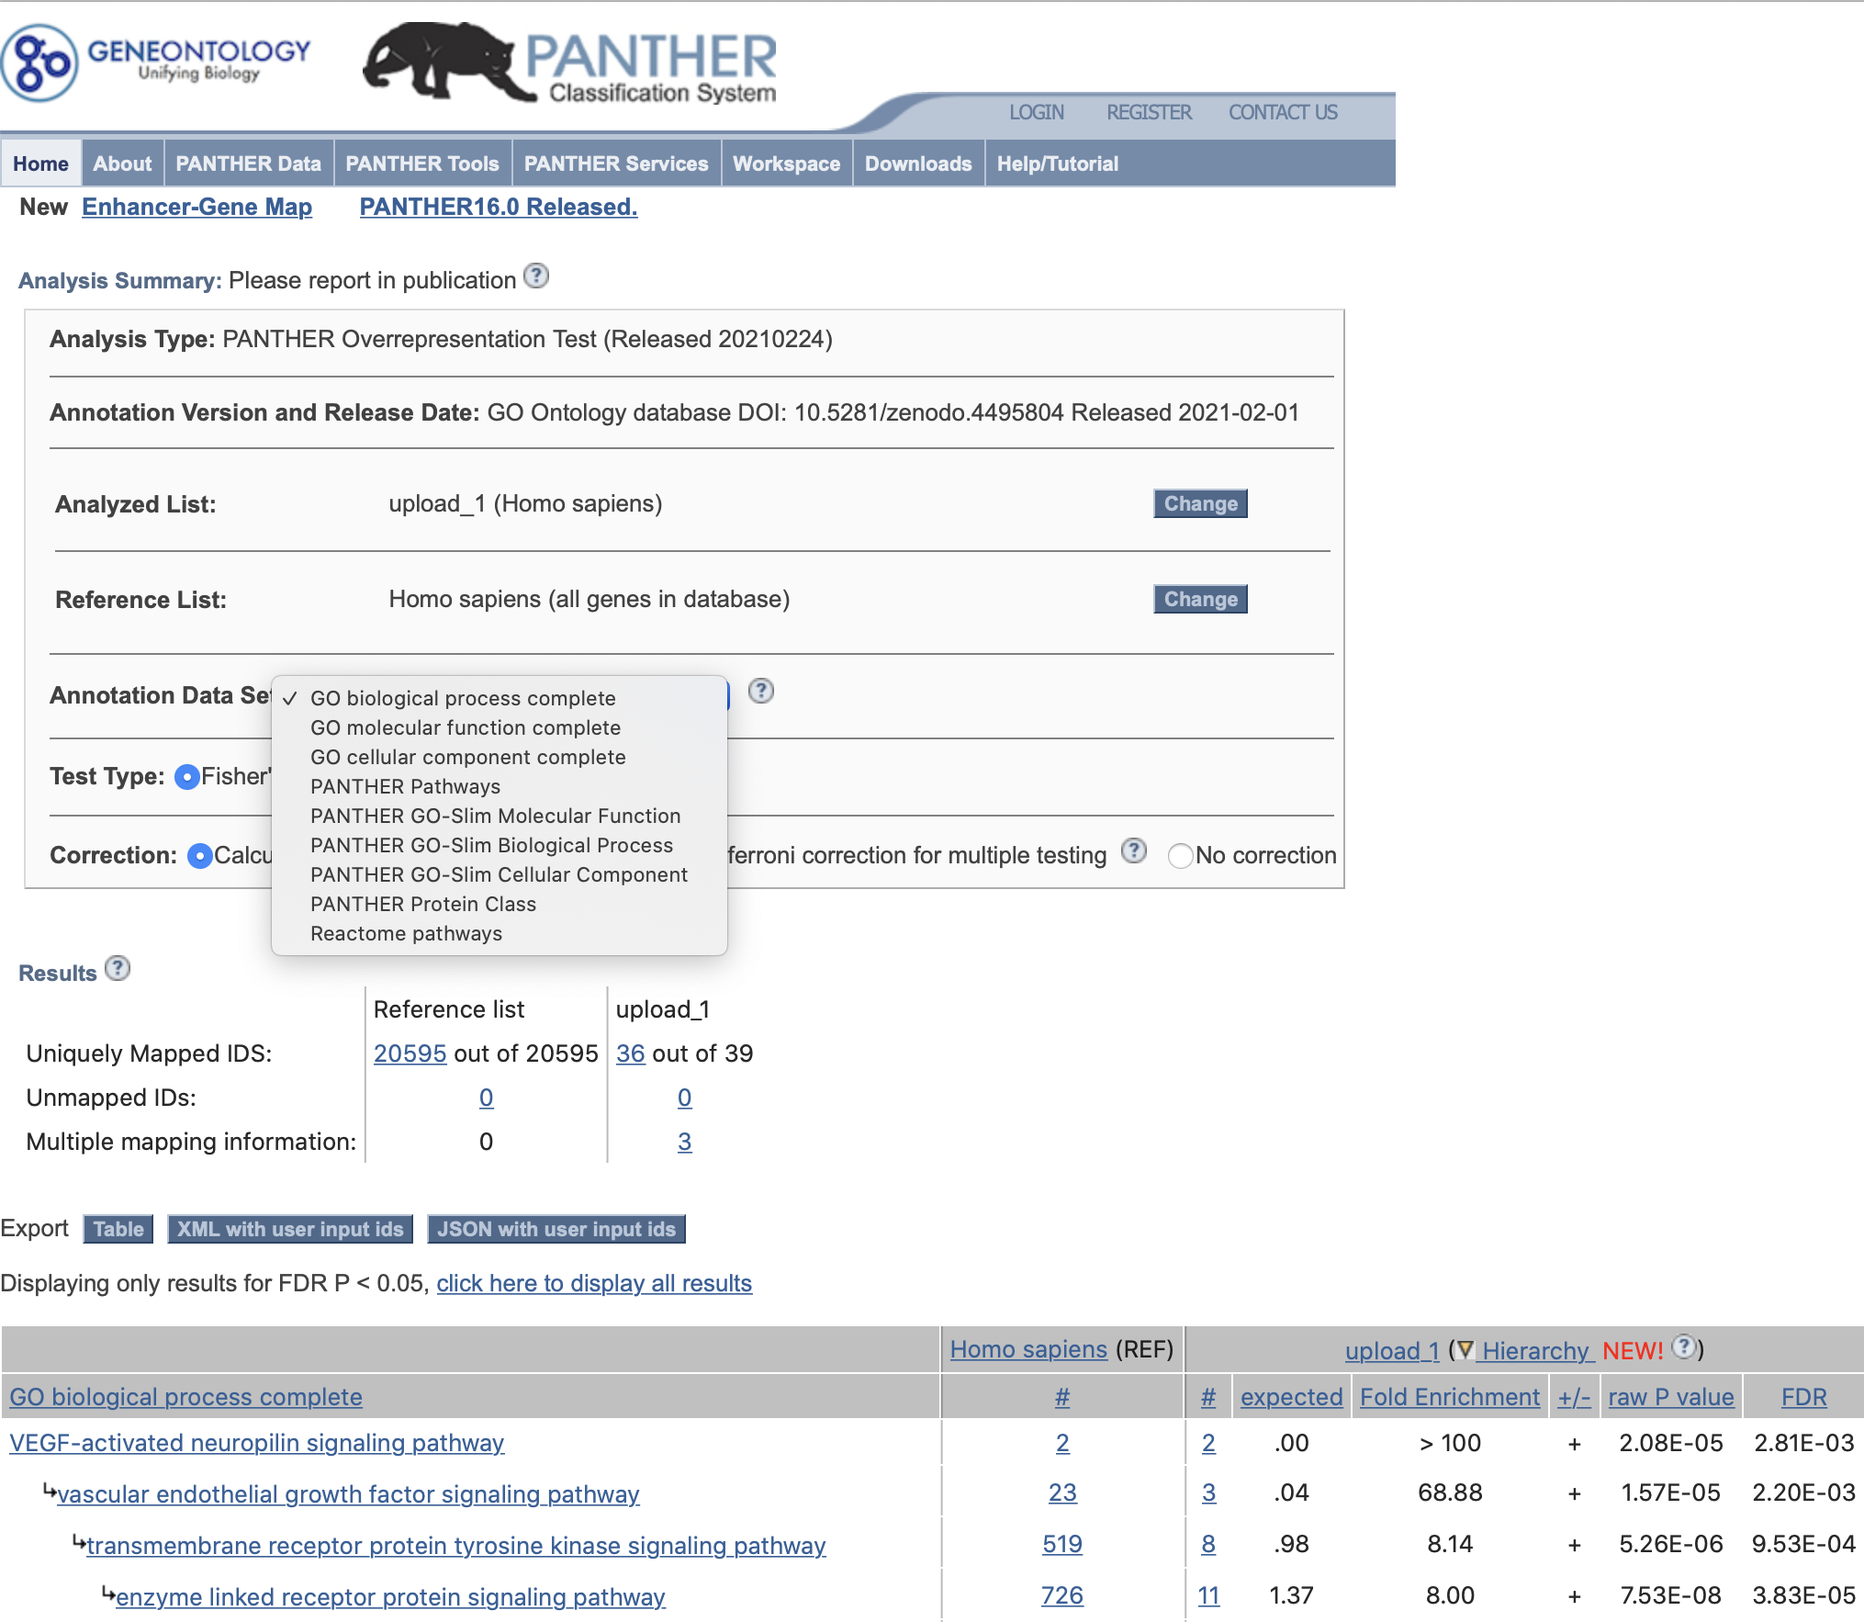
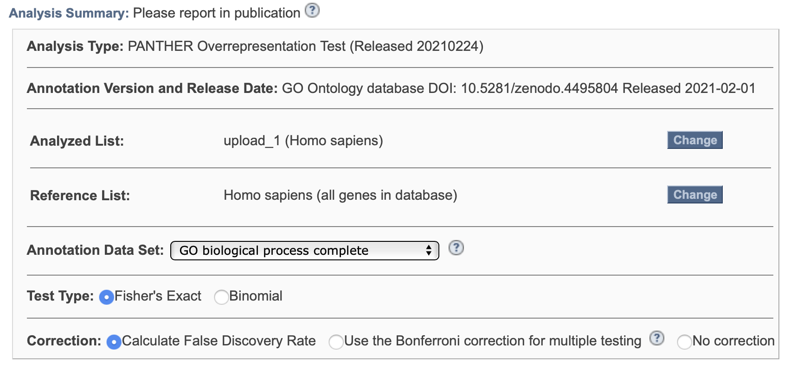
GO enrichment analysis (PANTHER)
PANTHER results page. Notice you can select different gene sets/ontology sets and different statistical options.

Slide 34
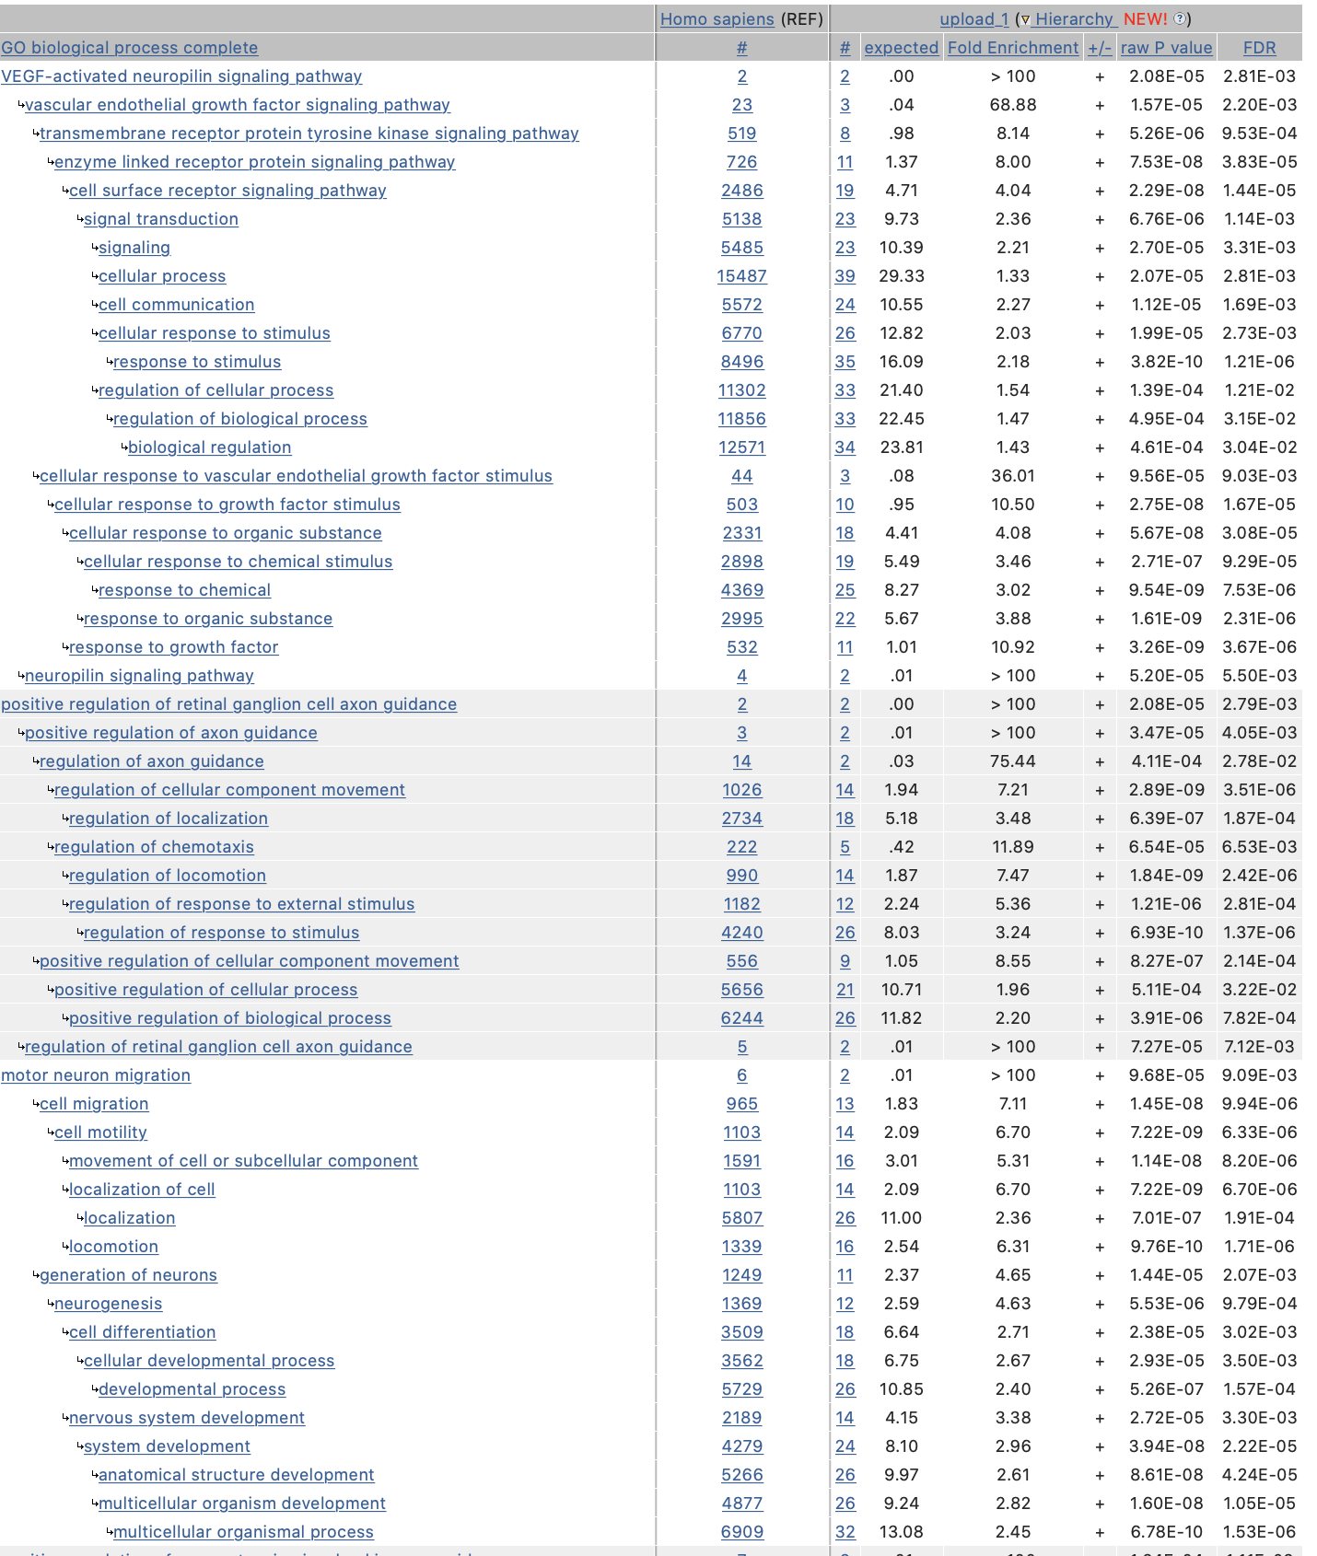
GO enrichment analysis (PANTHER)
Number of genes in your gene set mapping to a given annotation (vs expected)
# /( expected #)
PANTHER results
Total number of human genes mapping to a given annotation
Enriched vs. depleted
P-value and false discovery rate
Test each annotation for enrichment
Grouped by narrowest annotation category
Sorted within group from most specific to most general

Slide 35
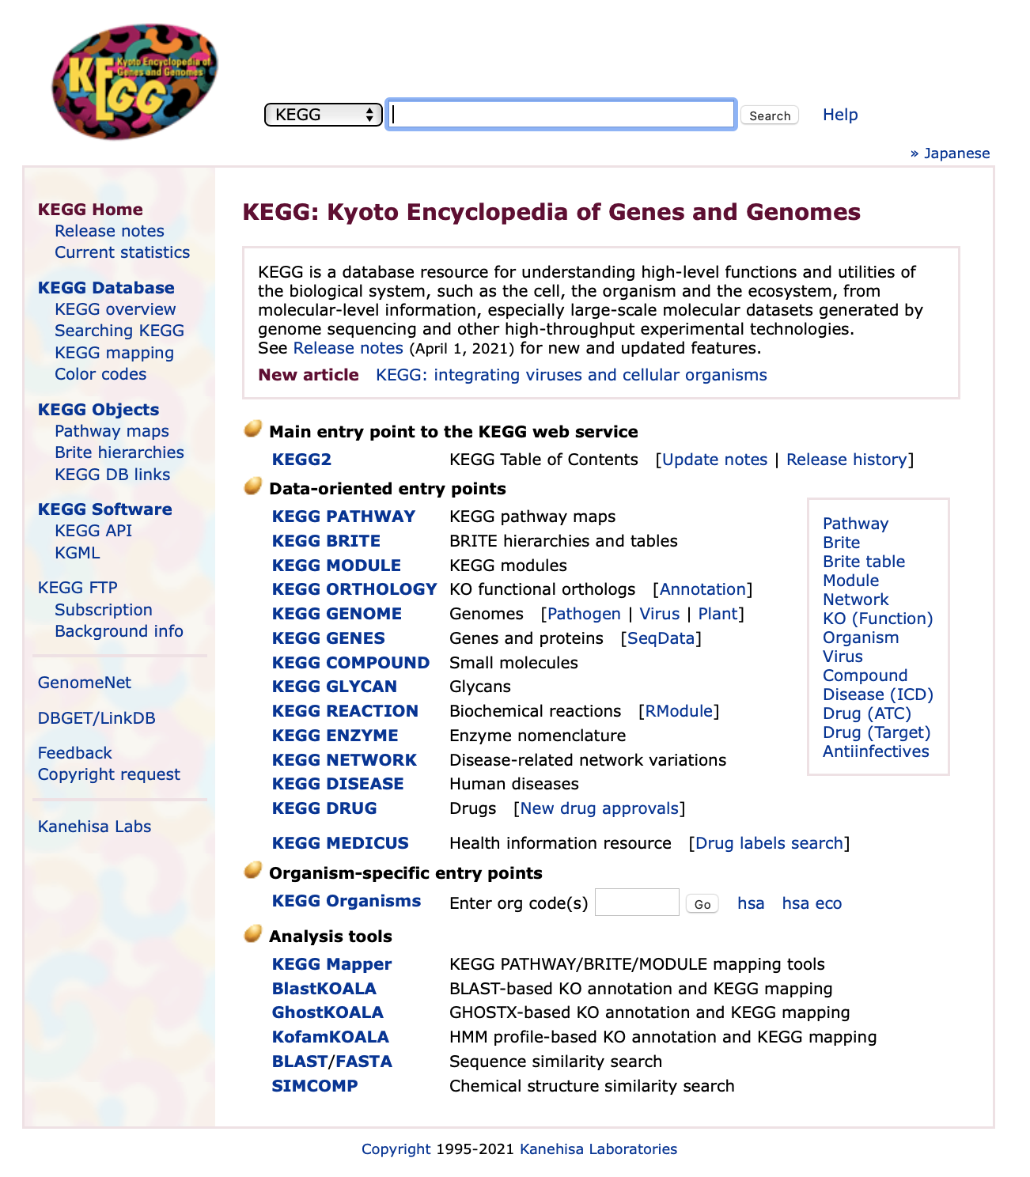
KEGG
https://www.genome.jp/kegg/
KEGG is a set of related databases.
KEGG PATHWAY is the most important part for our purposes.

Slide 36
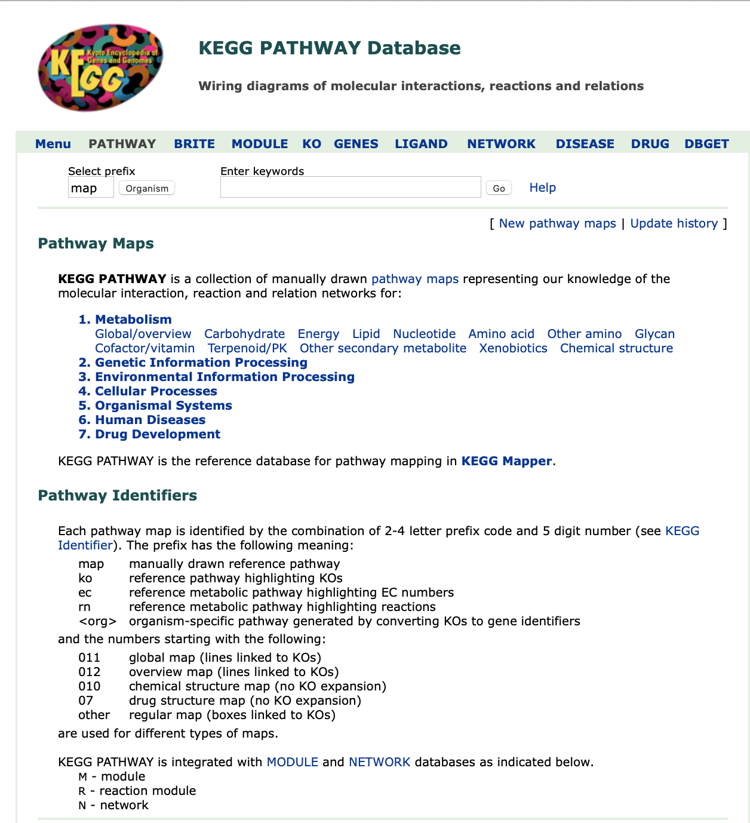
KEGG PATHWAY
A collection of manually drawn pathway maps.
Pathways fall into 7 categories.

Slide 37
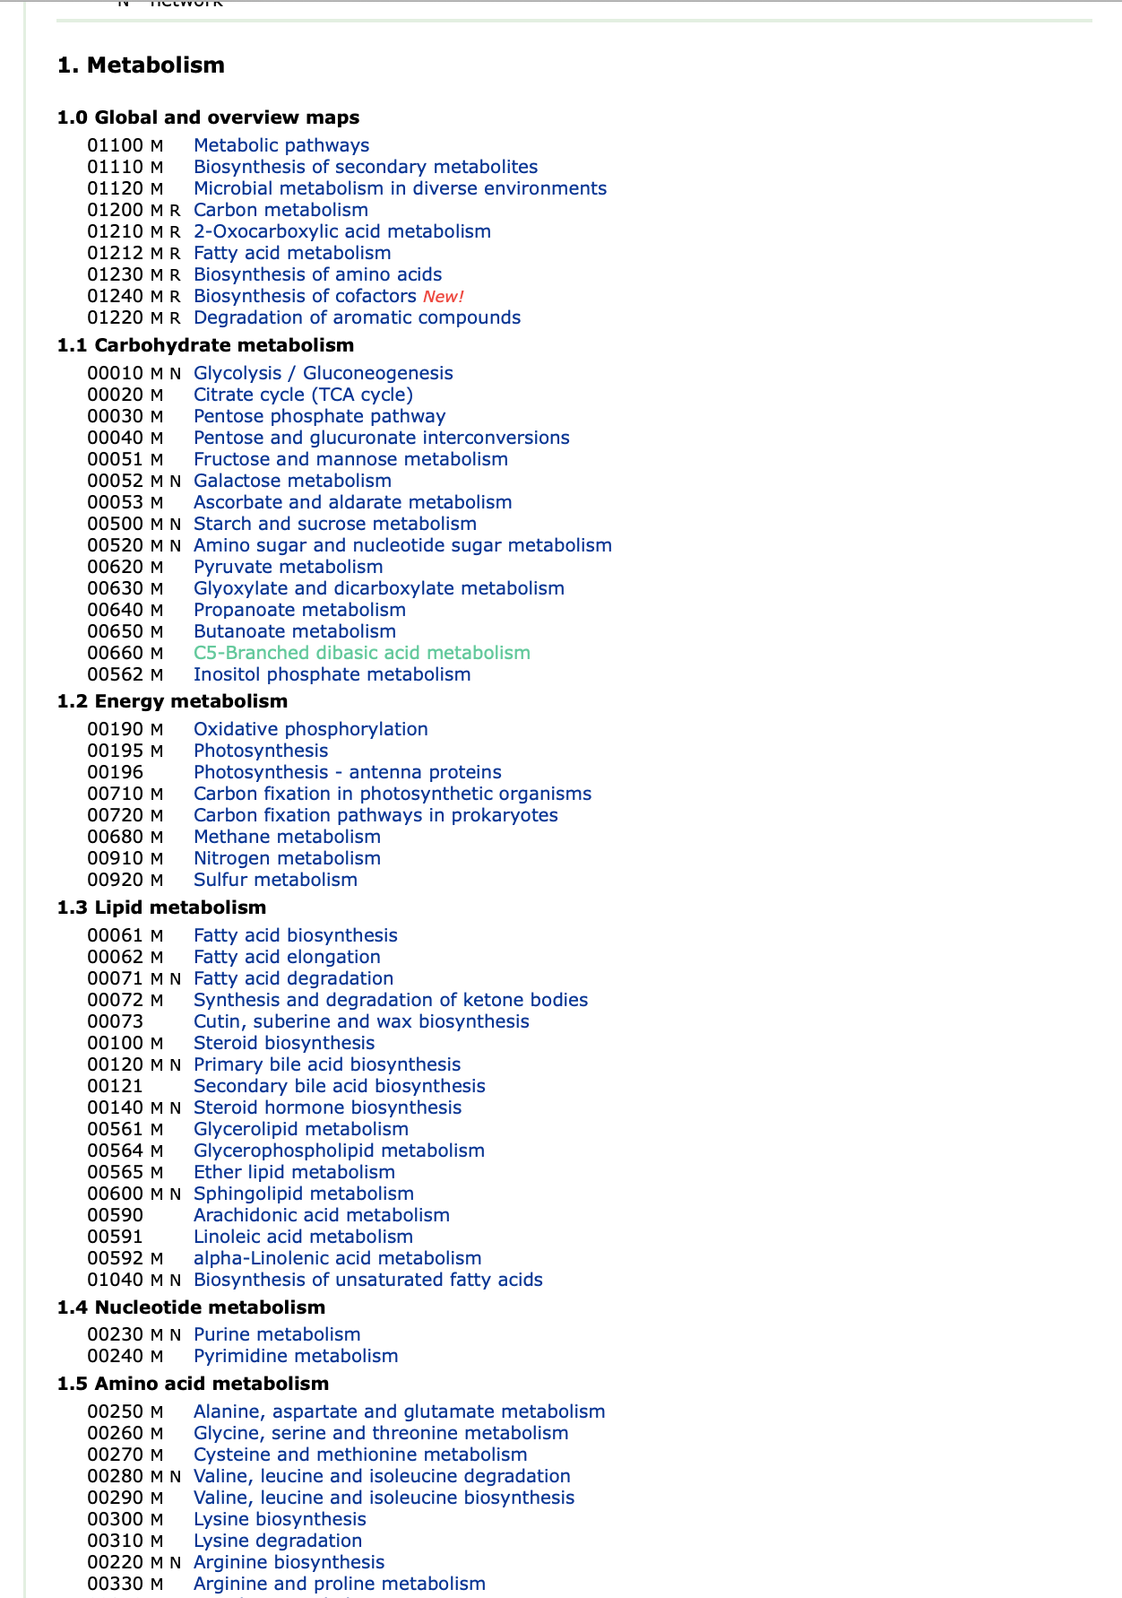
KEGG PATHWAY
A few of the KEGG pathways.
Let’s select “Metabolic pathways” (the entire category).

Slide 38
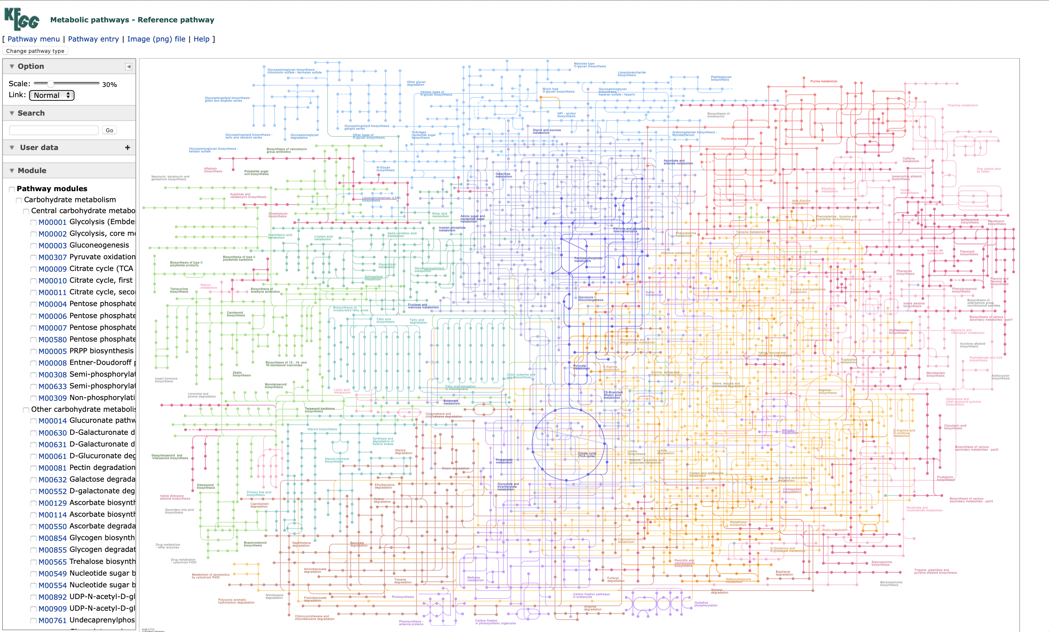

Slide 39
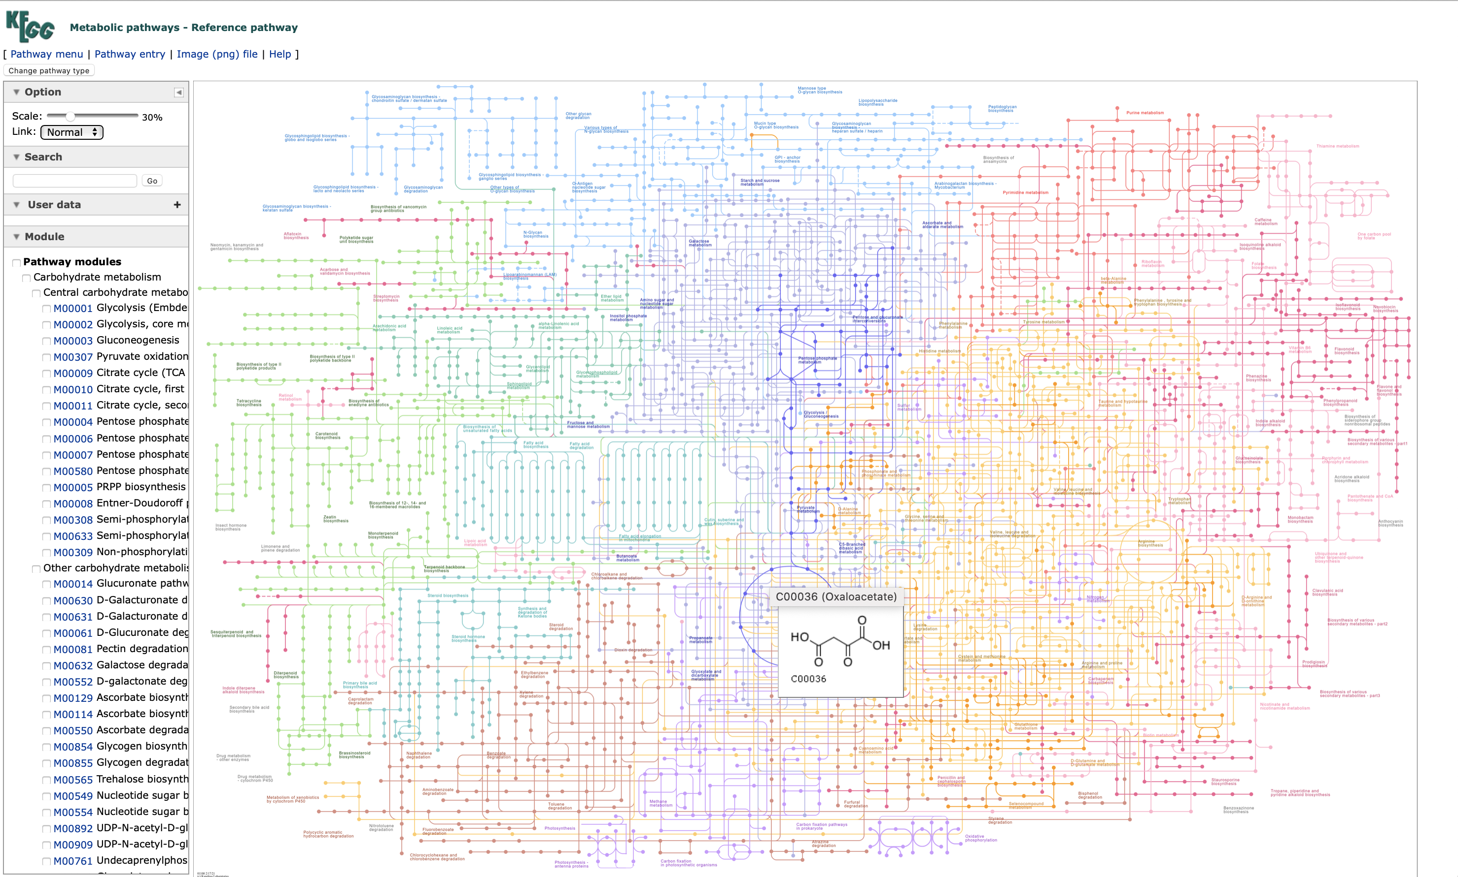

Slide 40
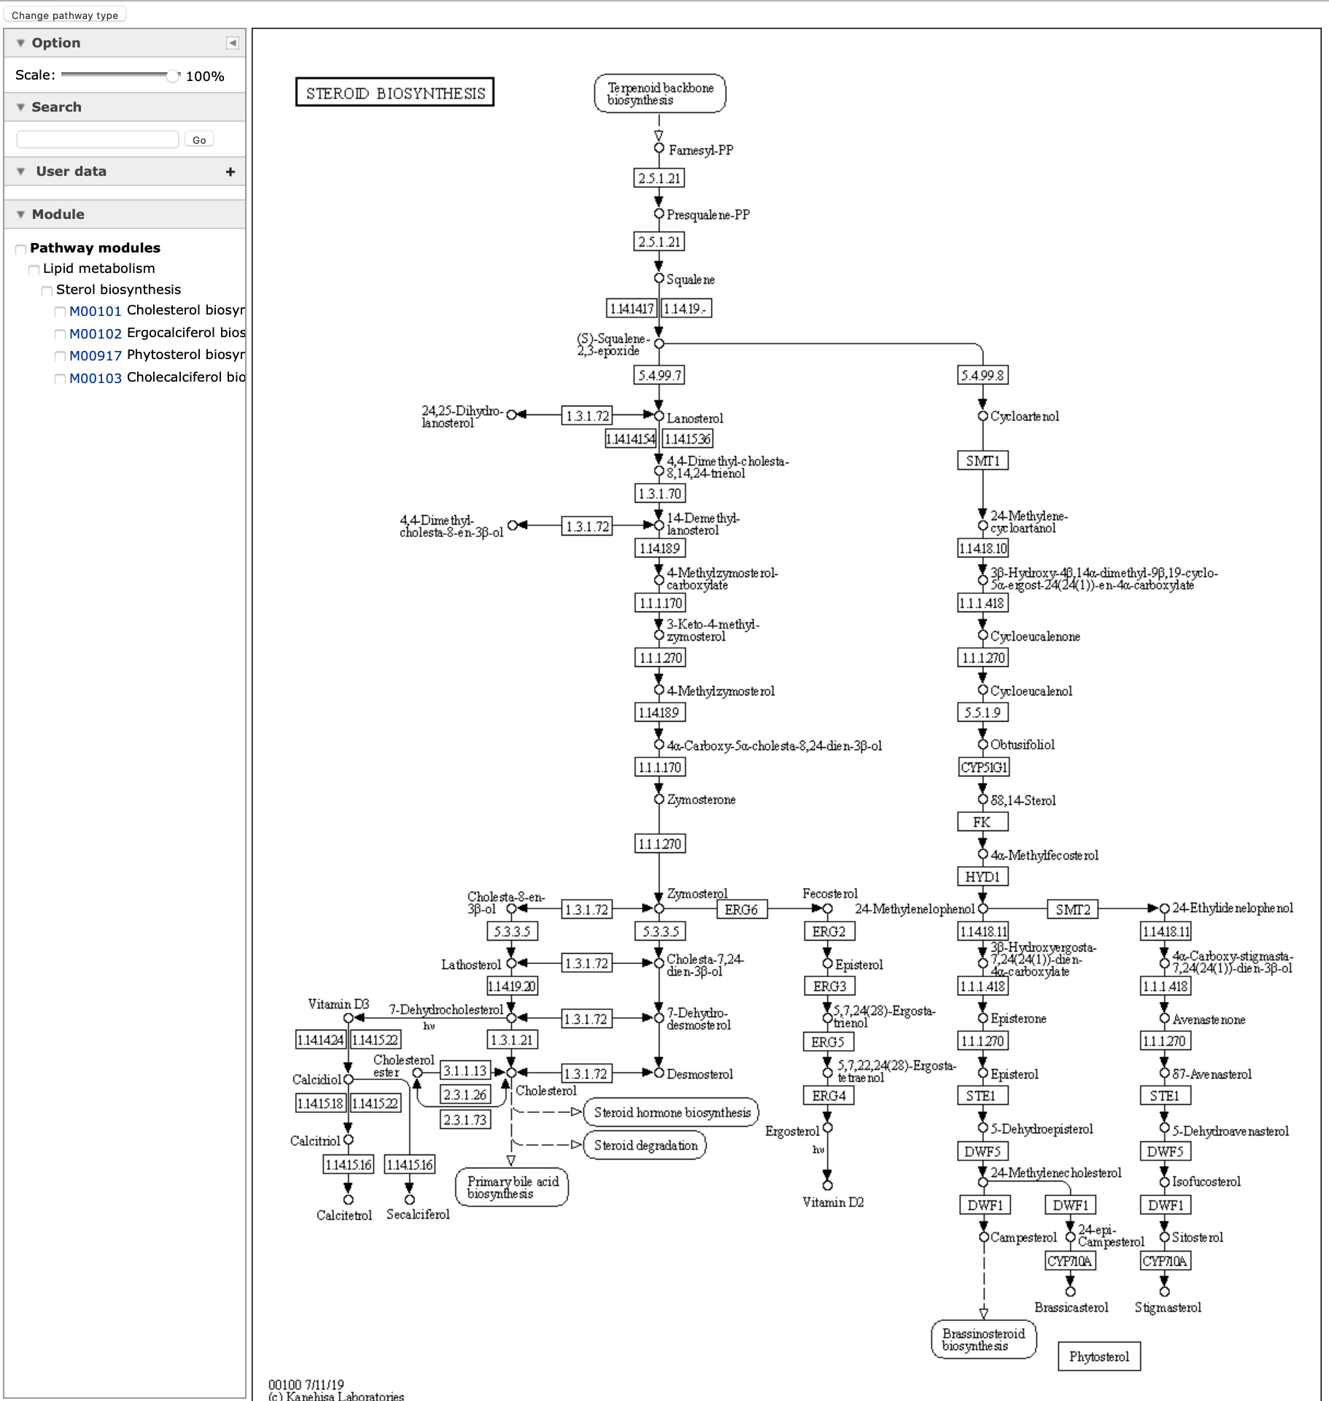
KEGG
Selecting the “steroid biosynthesis” pathway

Slide 41
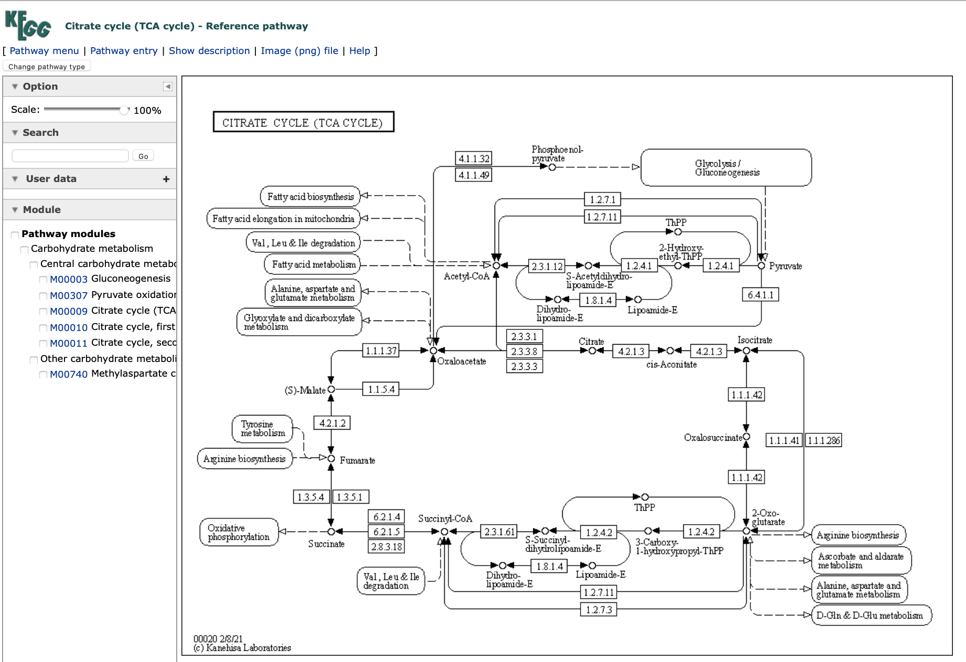
KEGG
Selecting TCA cycle
Click on a component, e.g.,
succinate

Slide 42
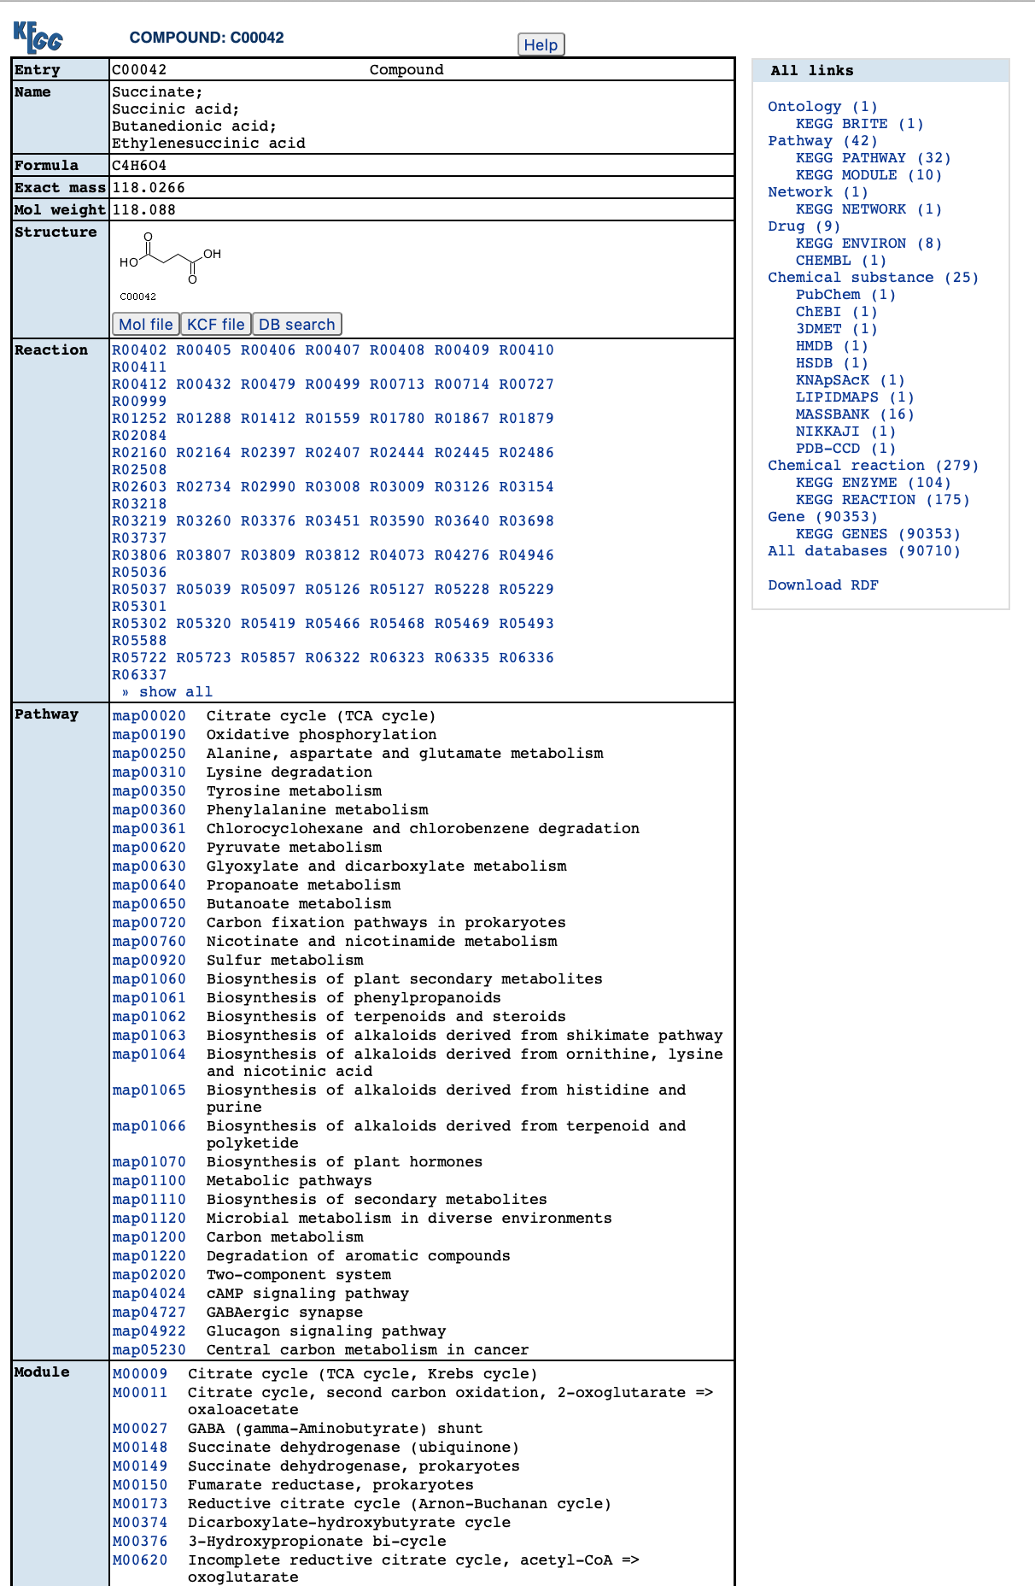
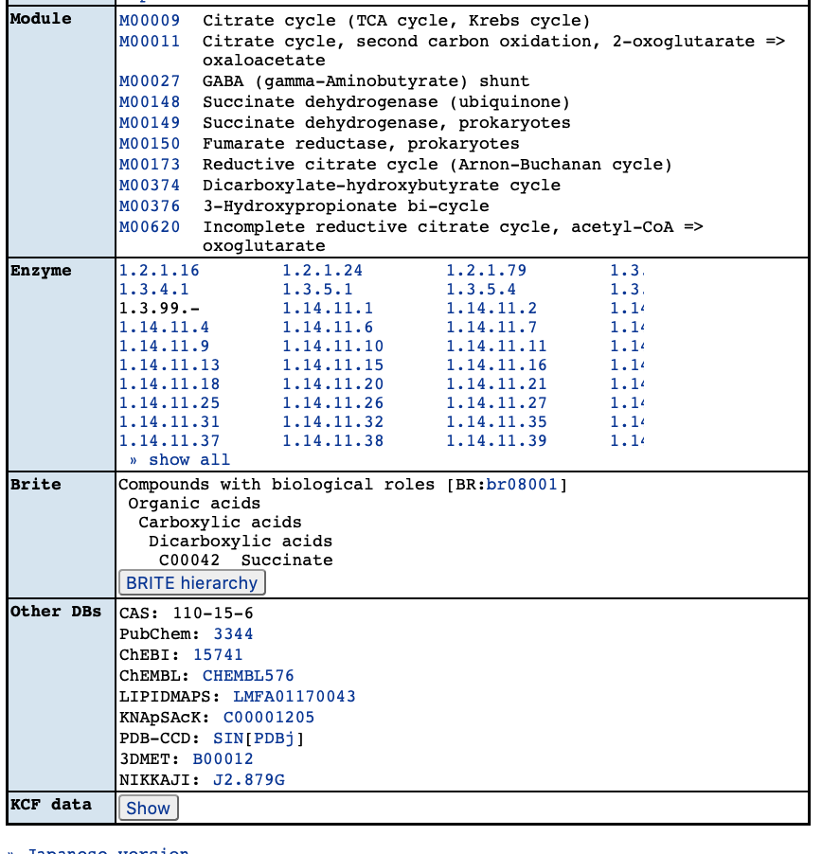
succinate

Slide 43
KEGG
Go back to the map and choose and enzyme (6.2.1.4)

Slide 44
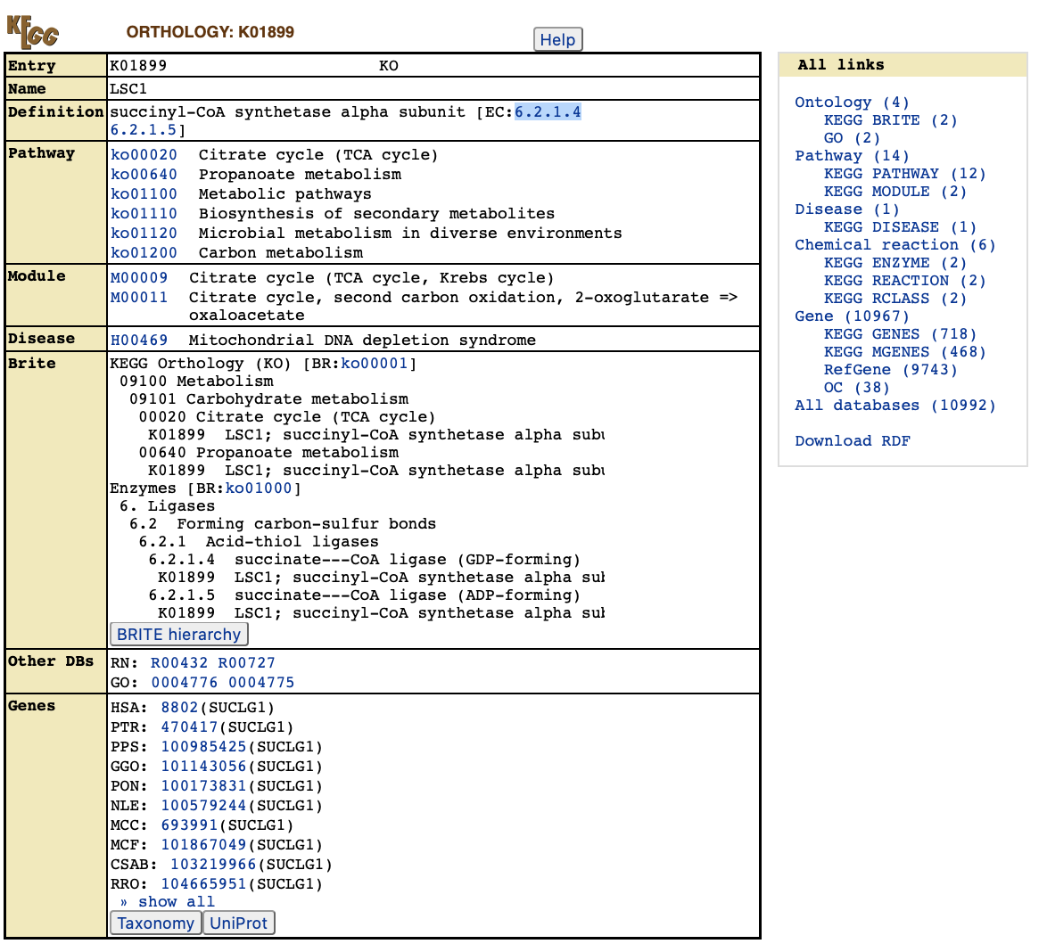
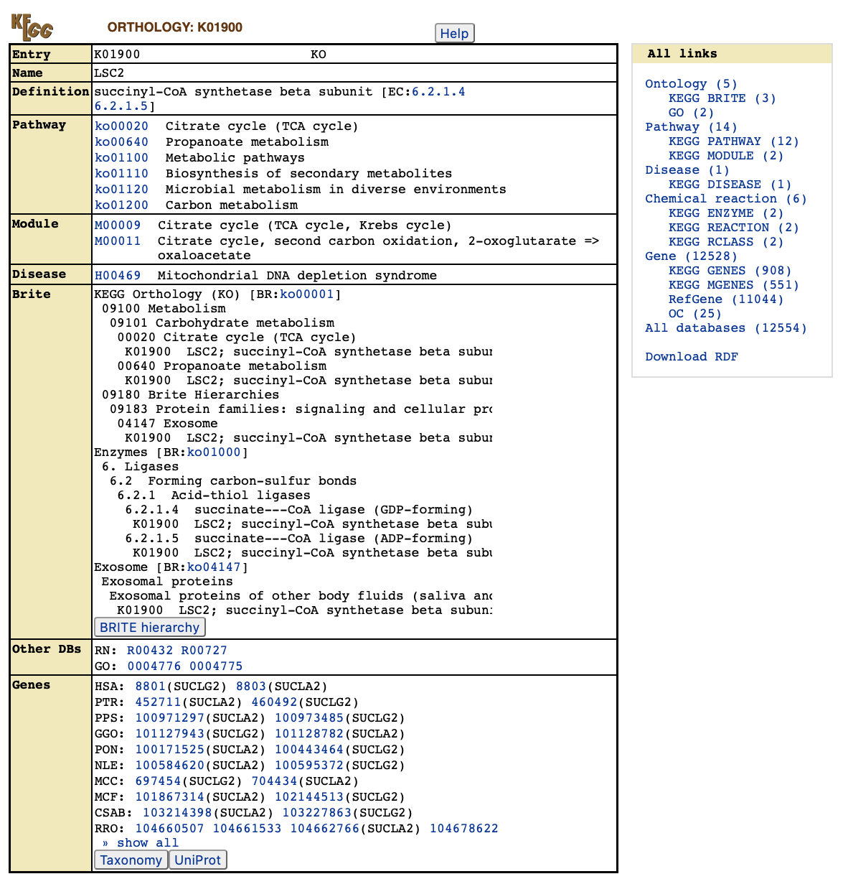
KEGG

Slide 45
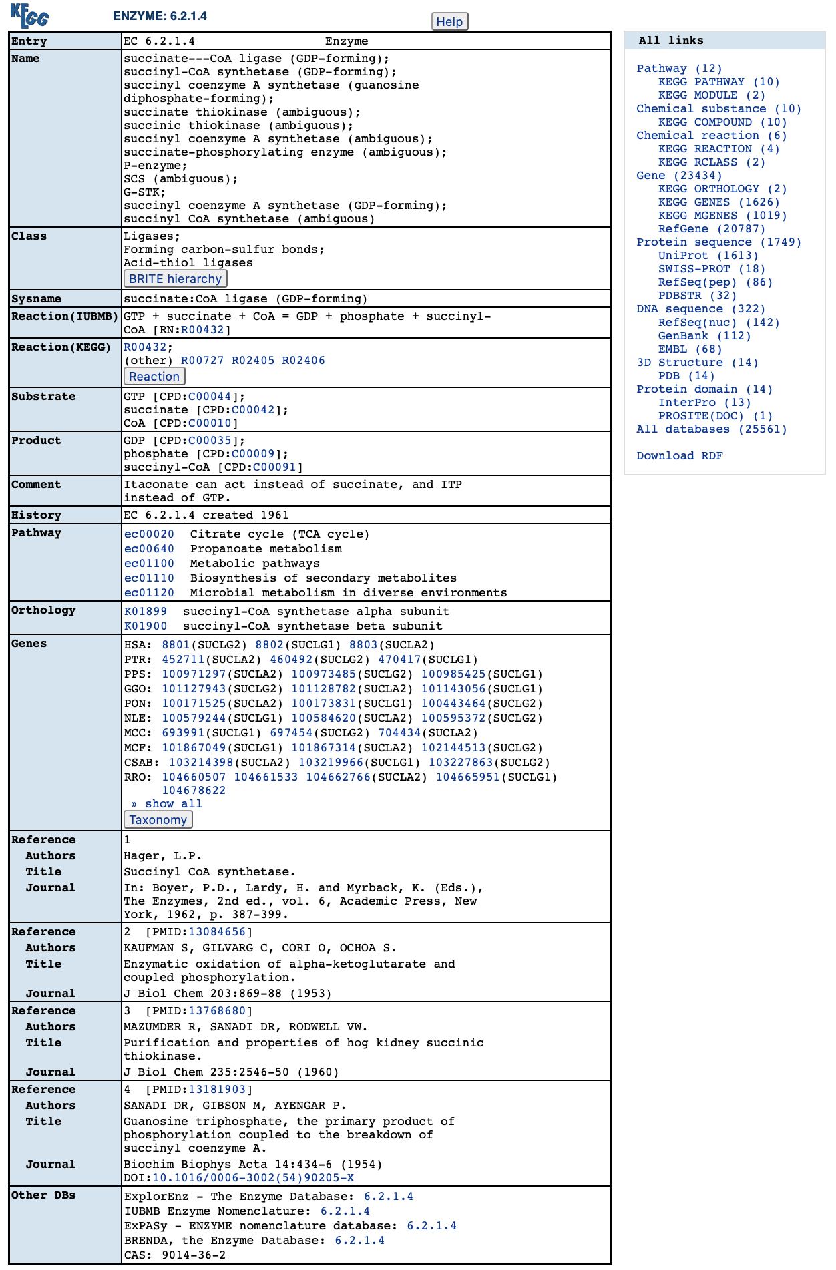
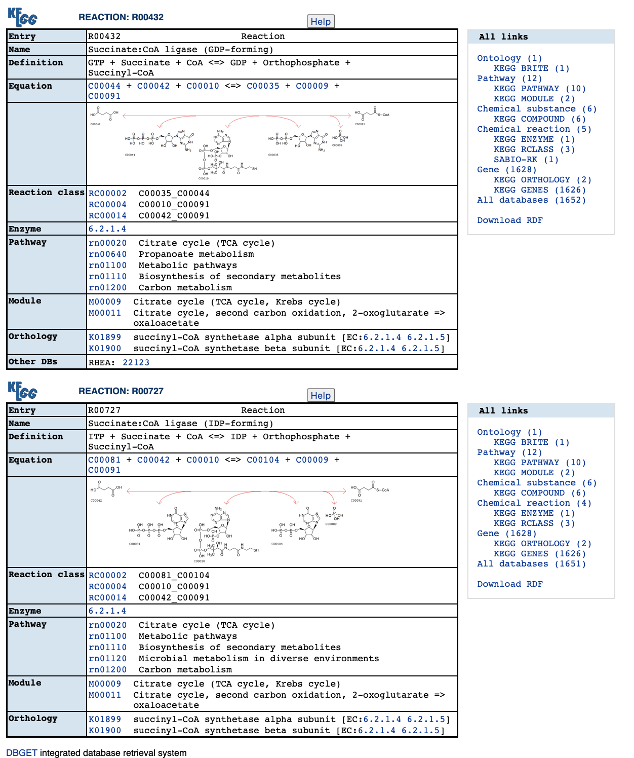

Slide 46
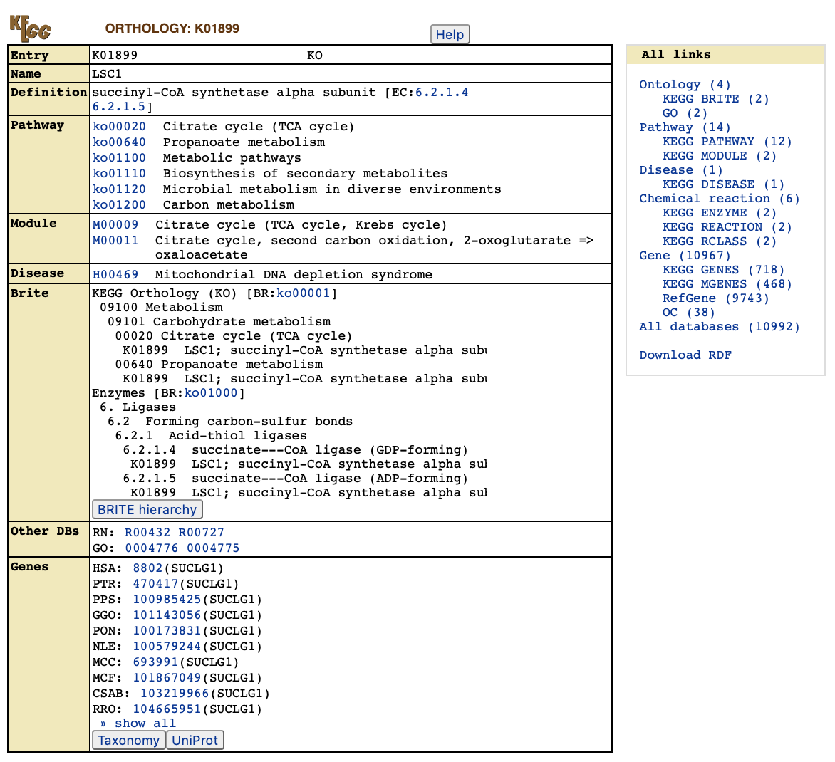
KEGG
Select the human gene

Slide 47
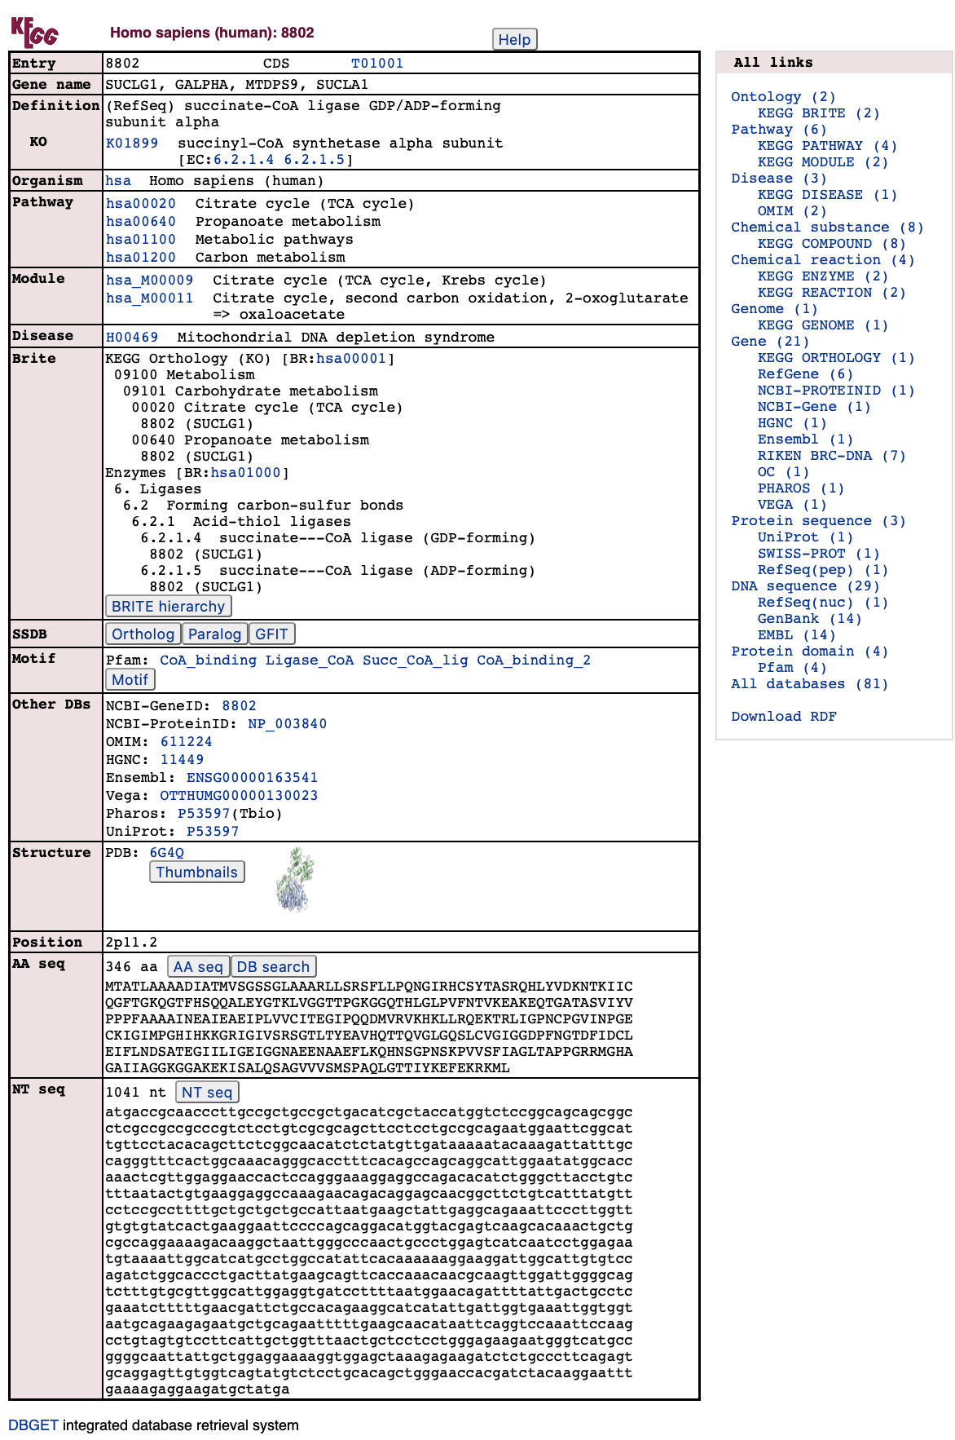
KEGG
Gene information for SUCLG1.
Pathways/modules the gene is associated with are listed.
There are links to other databases.

Slide 48
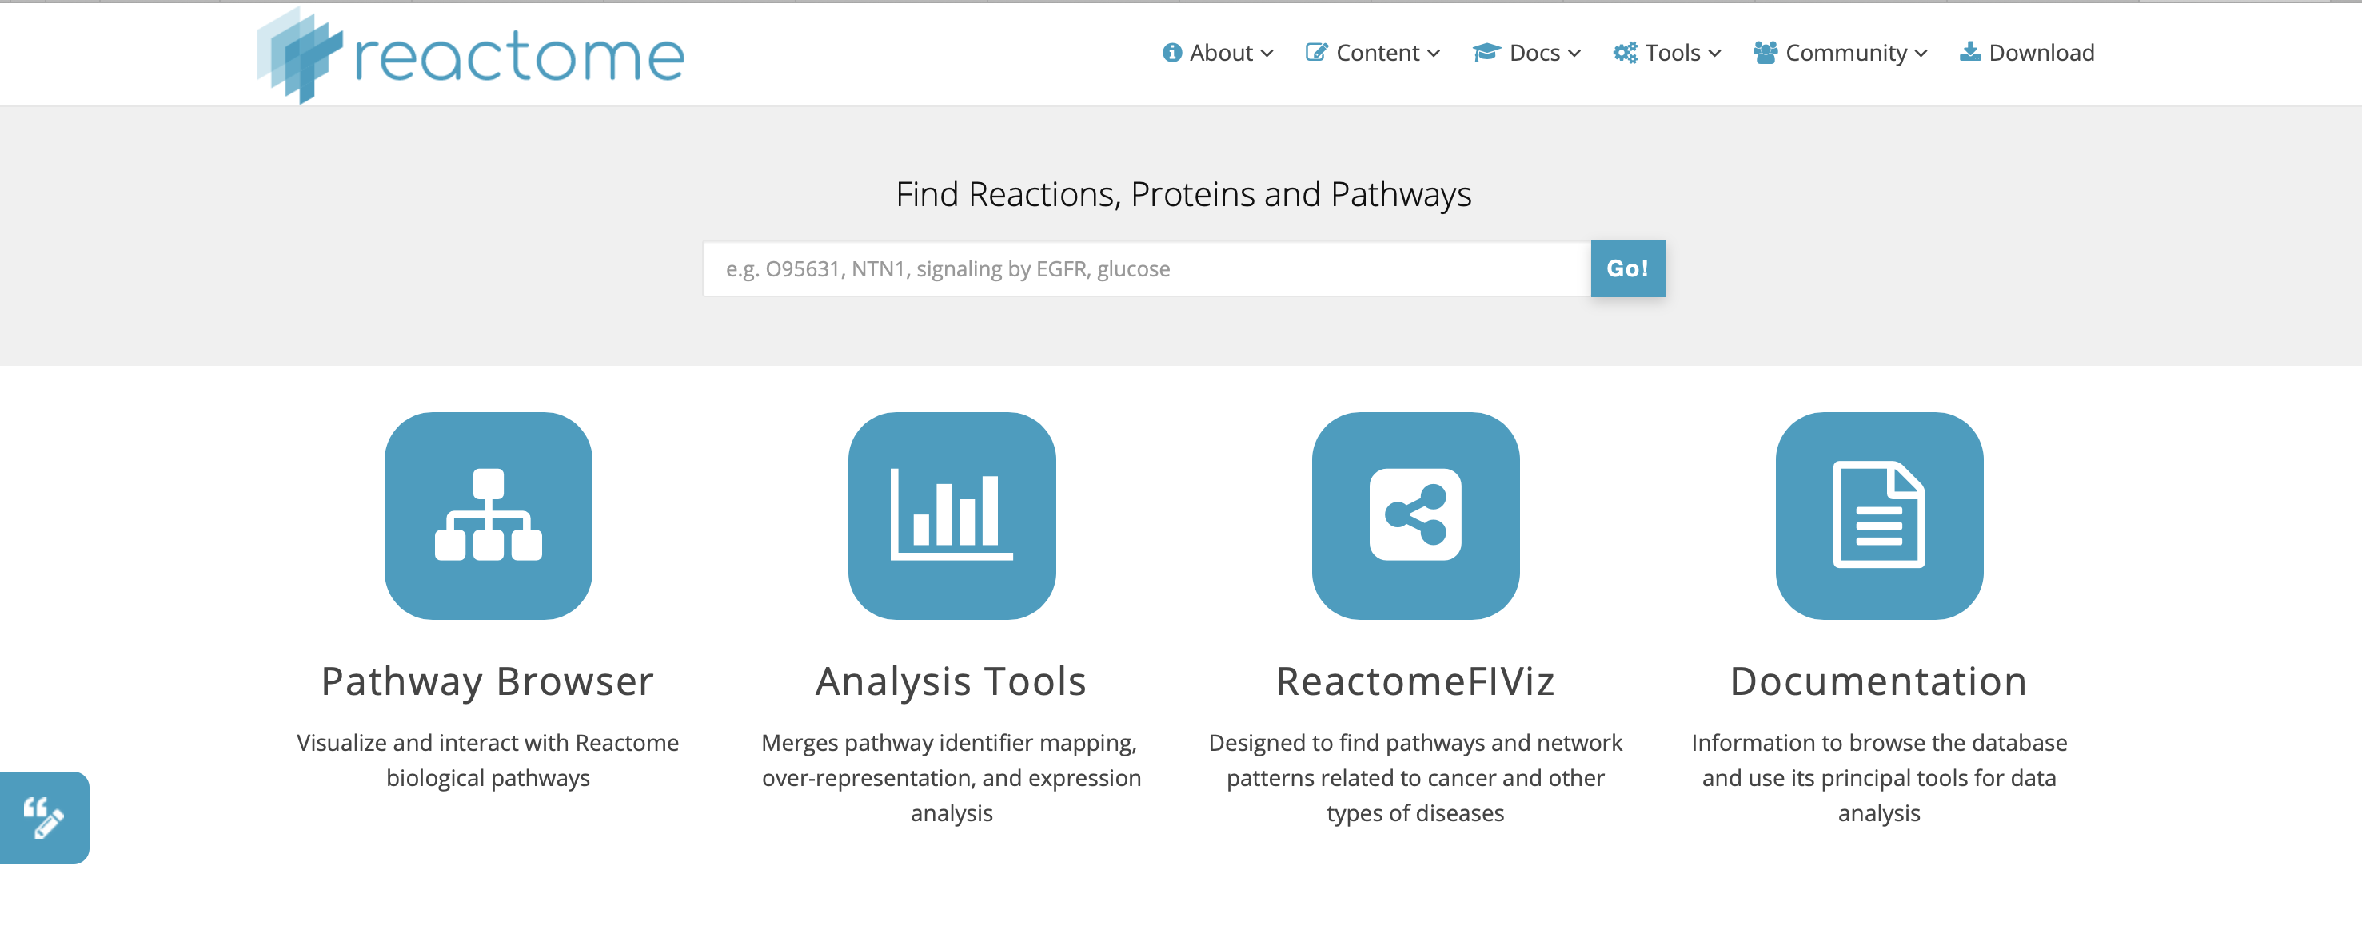
Reactome
reactome.org
Reactome is an online pathway database, with a focus on reactions.

Slide 49
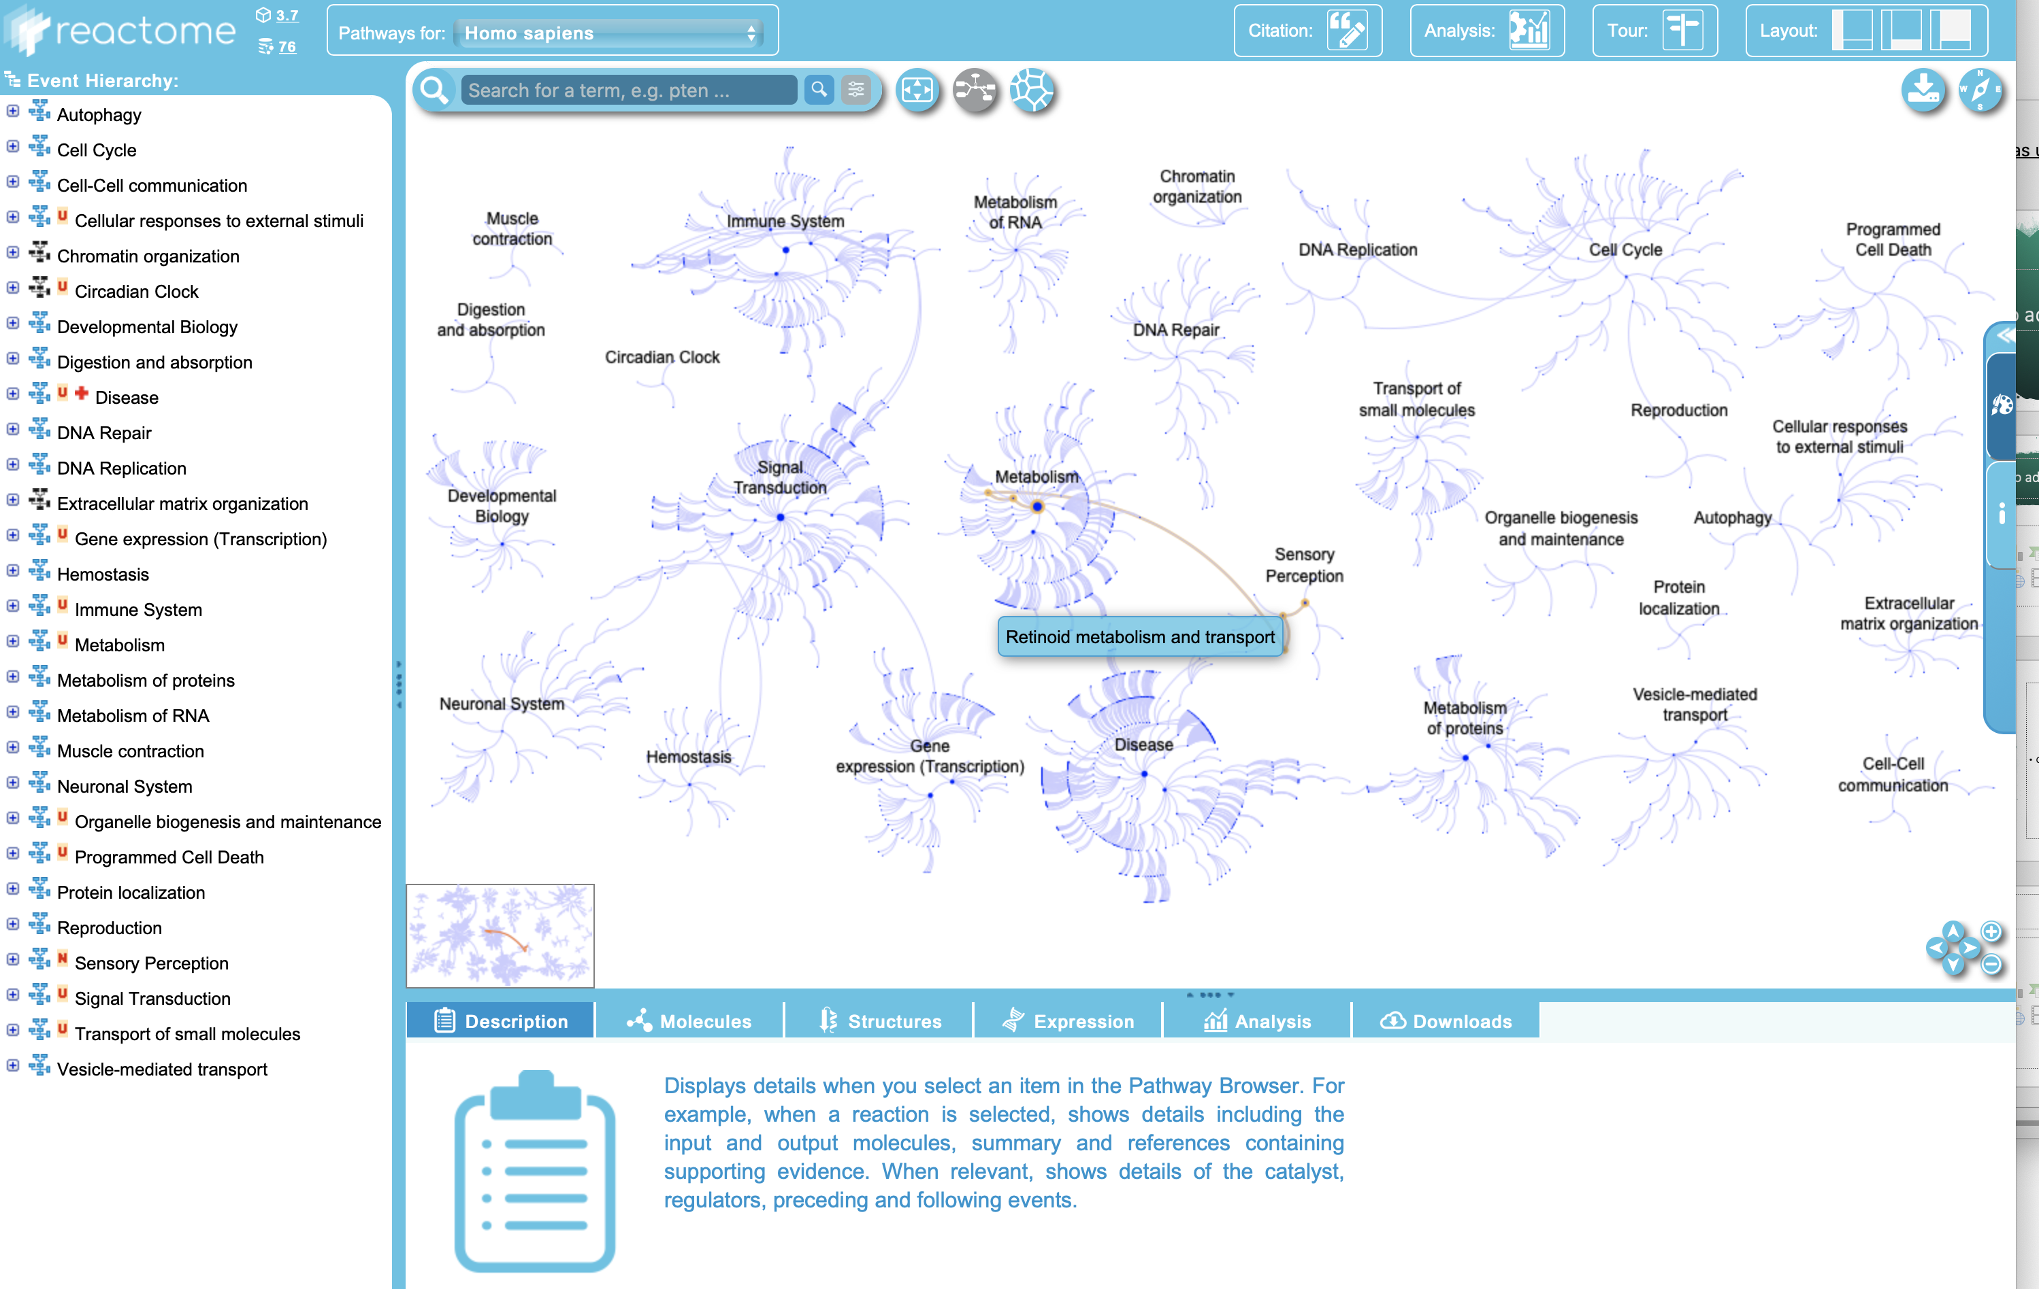
Reactome
https://reactome.org/PathwayBrowser/

Slide 50
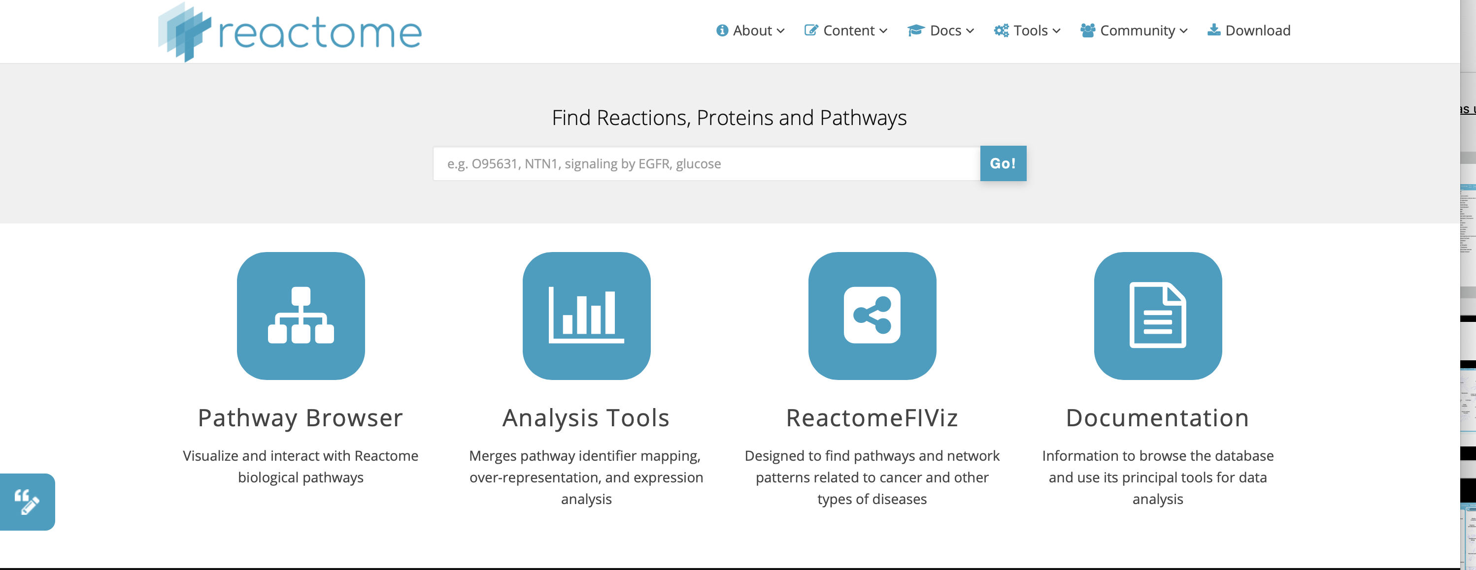
Reactome

Slide 51
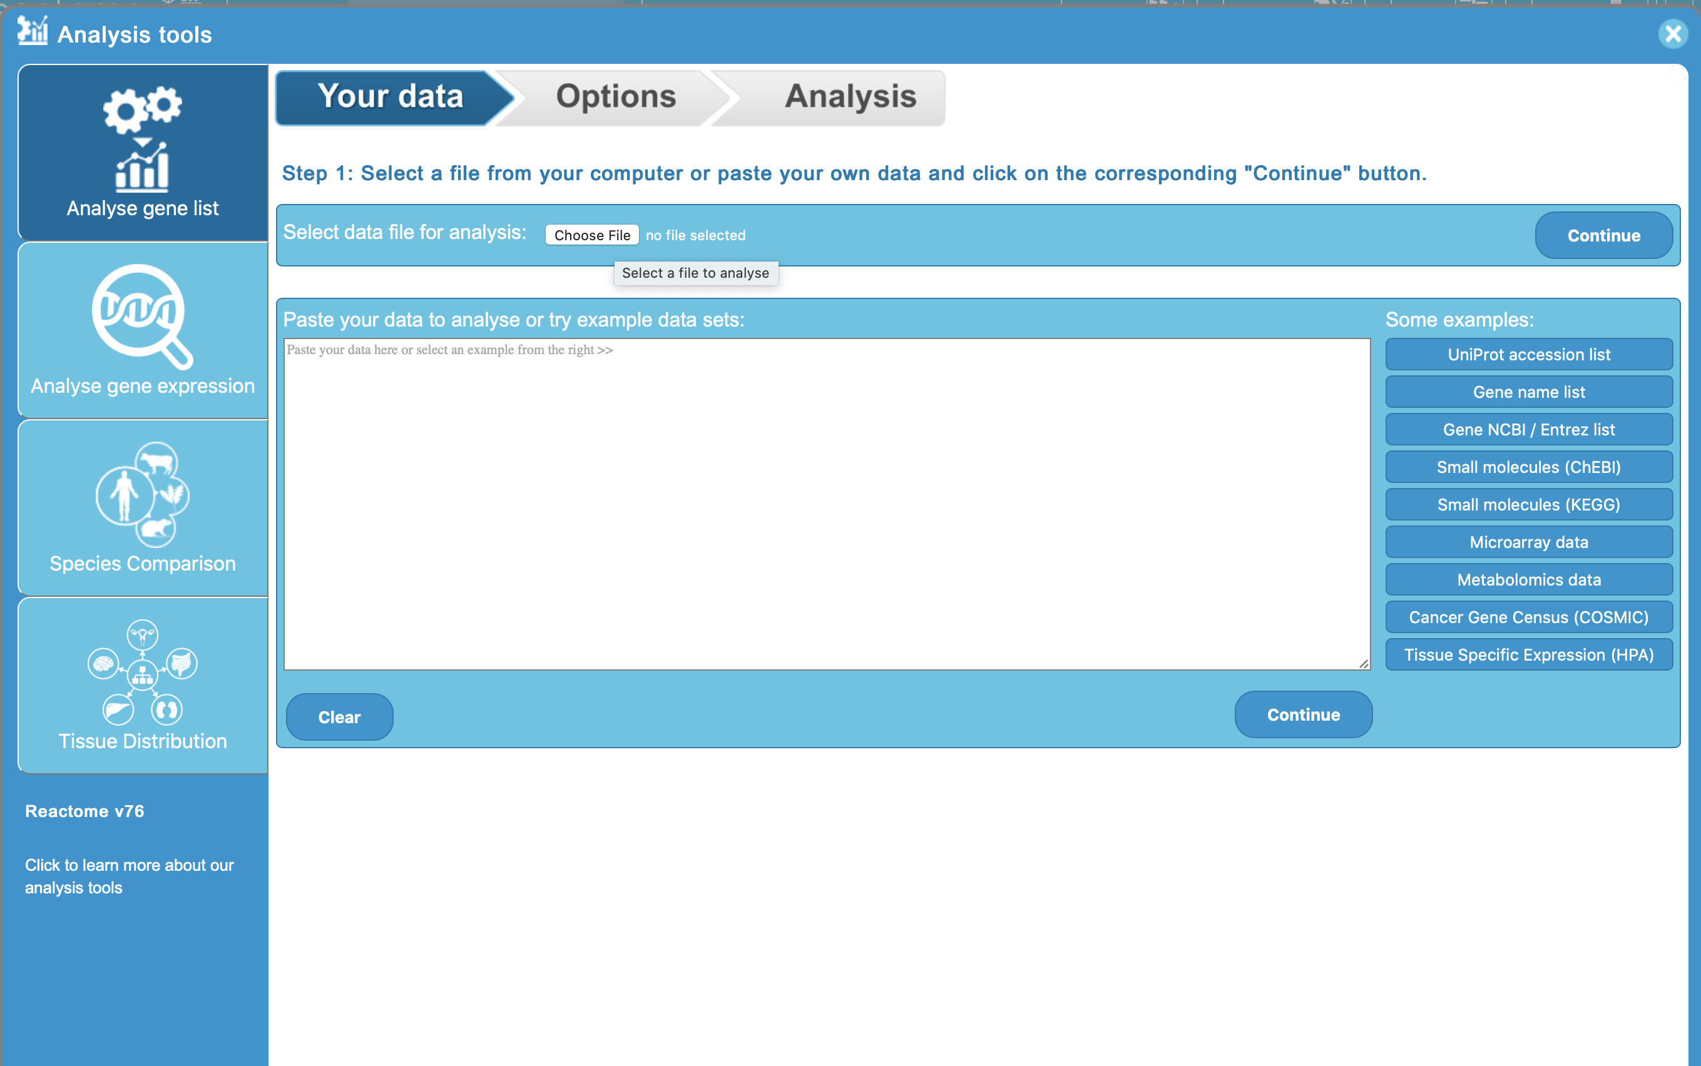
Reactome
Input:
SENP7
MOB1B
CARMIL1
PRRC2A
TERF2
RFWD3
PARP1
POT1
ATM
MPHOSPH6

Slide 52
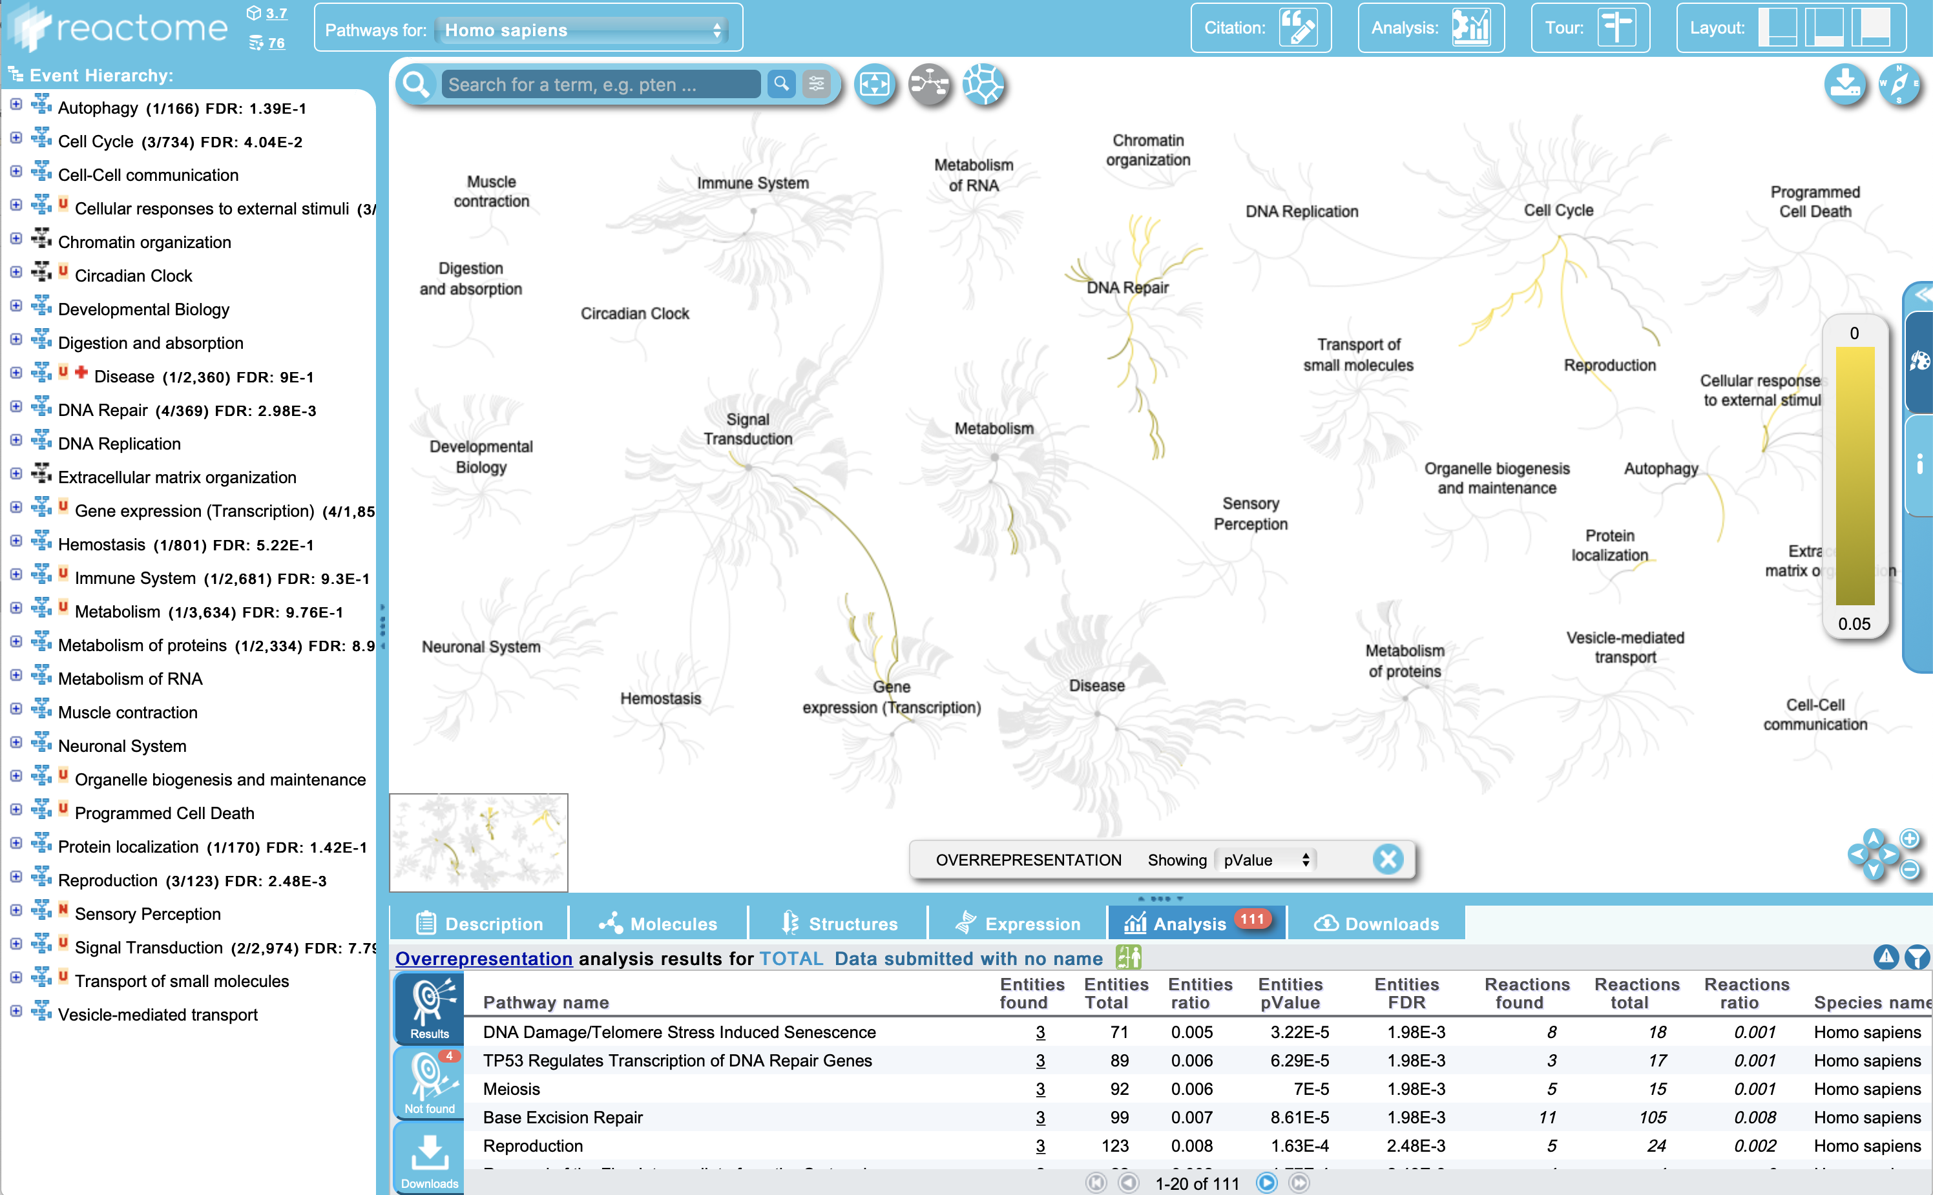
Reactome
Results

Slide 53
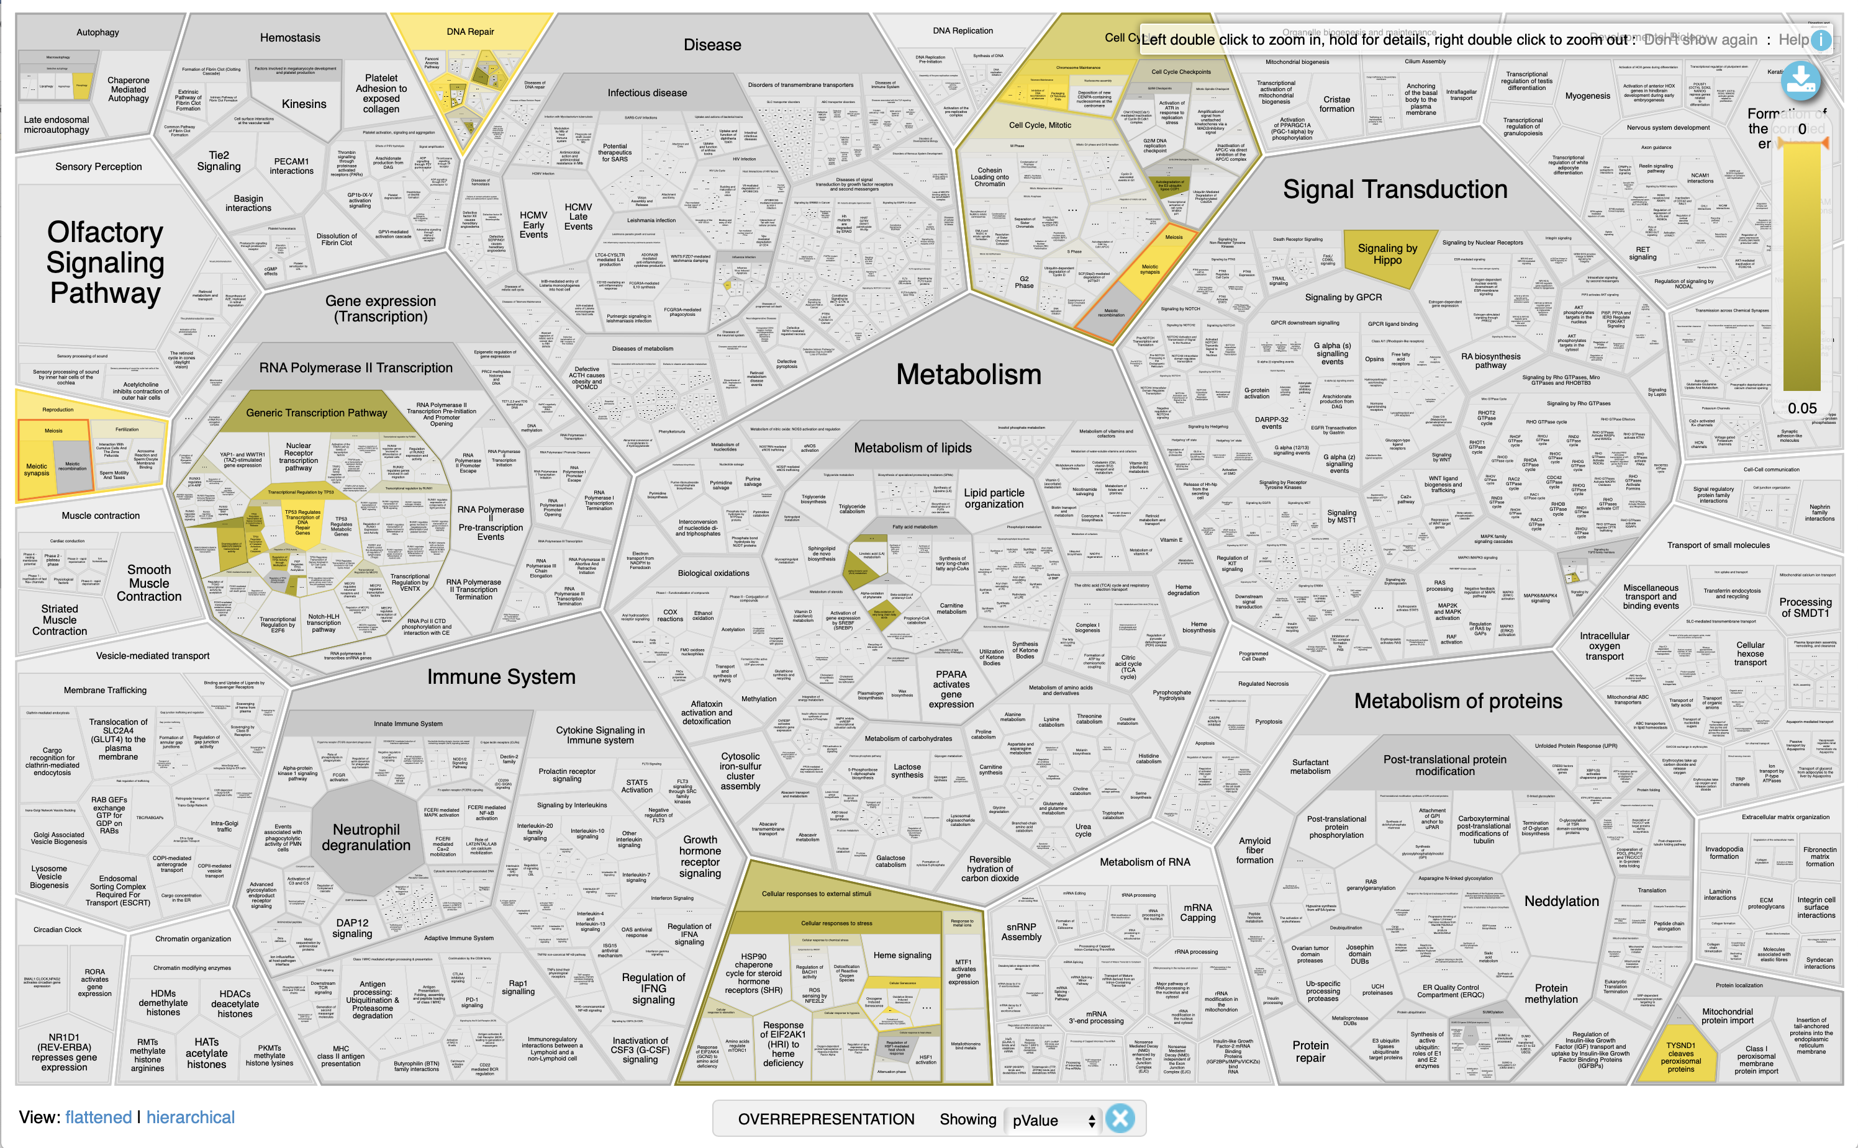
Reactome
Results

Slide 54
Gene set/pathway analysis in FUMA
Recall that FUMA’s SNP2GENE feature takes GWAS summary statistics and outputs a list of mapped genes.
The GENE2FUNC feature takes a set of genes as input and can perform overrepresentation analyses.
Gene sets include: Gene Ontologies, KEGG pathways, Reactome pathways, and DE genes across various tissues/cell types

Slide 55
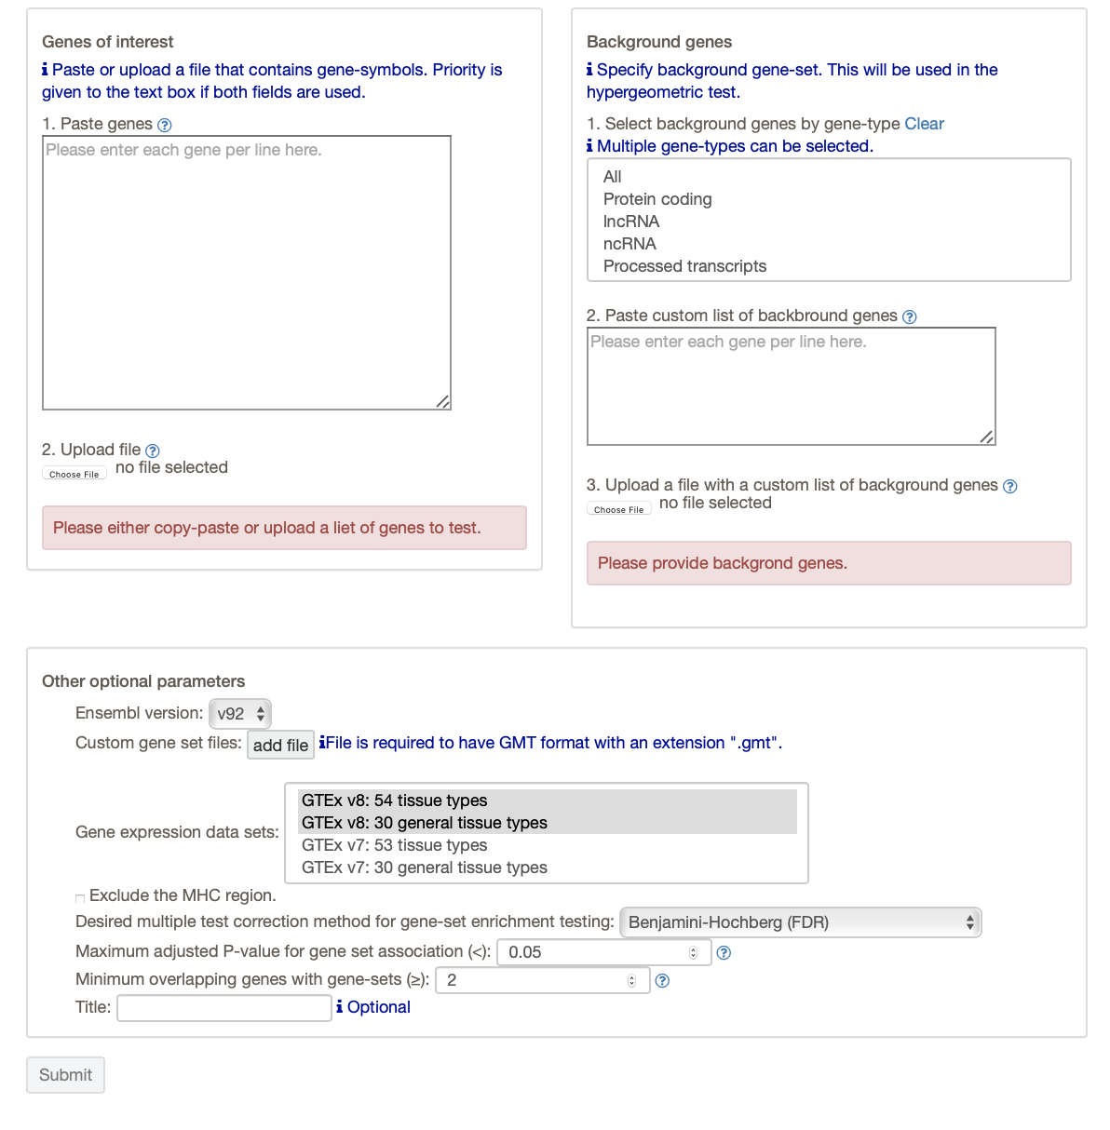
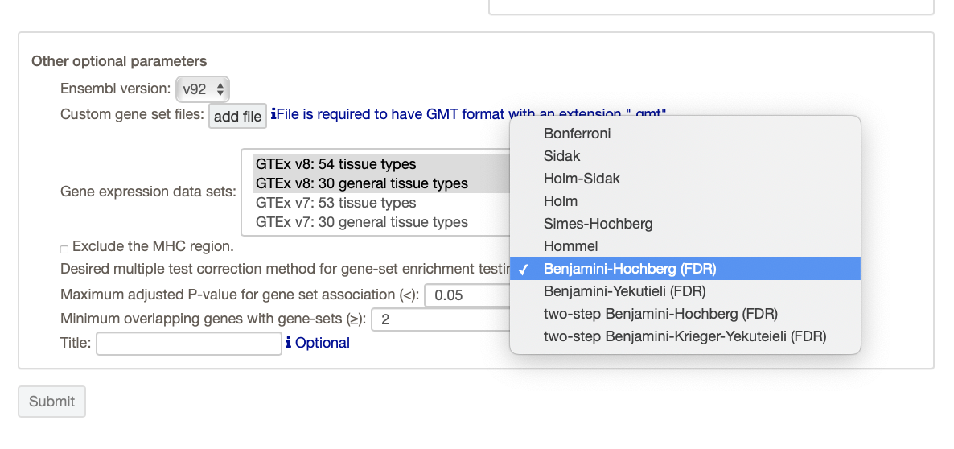
Gene set analysis in FUMA – GENE2FUNC
Provide a list of genes (copy and paste or upload a file).
You need to specify a “background” set of genes to compare your list with.
FUMA lets you select several different gene sets defined by gene expression profiles of various tissues.
You can also choose one of several multiple-testing correction methods and a “significance” threshold.

Slide 56
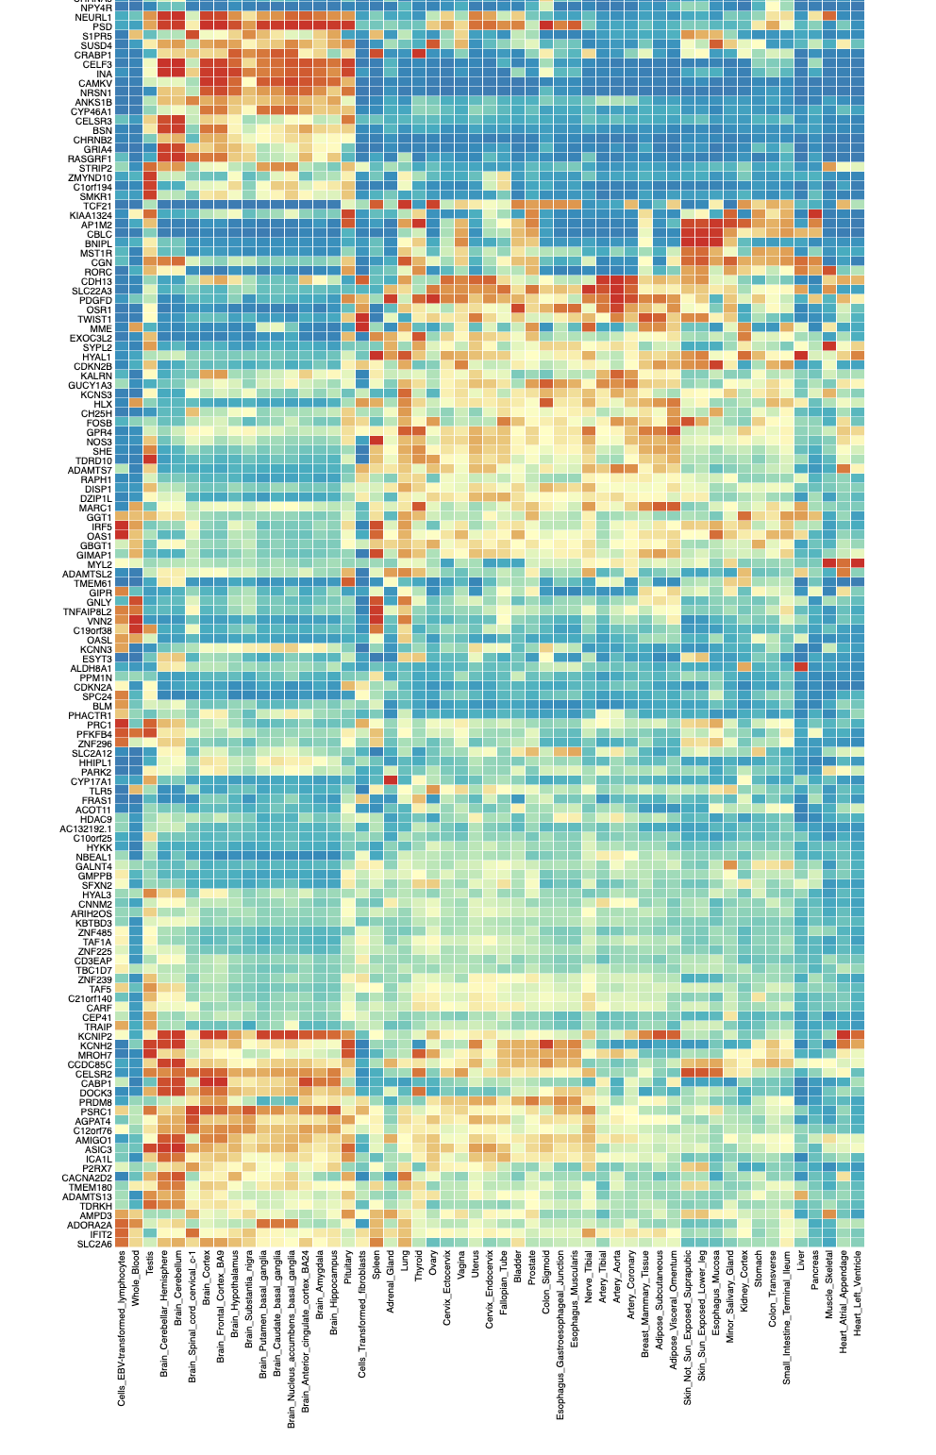
GENE2FUNC
Input: 644 genes from the hw4 data.
Output (first part): gene expression heatmap
https://fuma.ctglab.nl/browse/179#g2f_summaryPanel

Slide 57
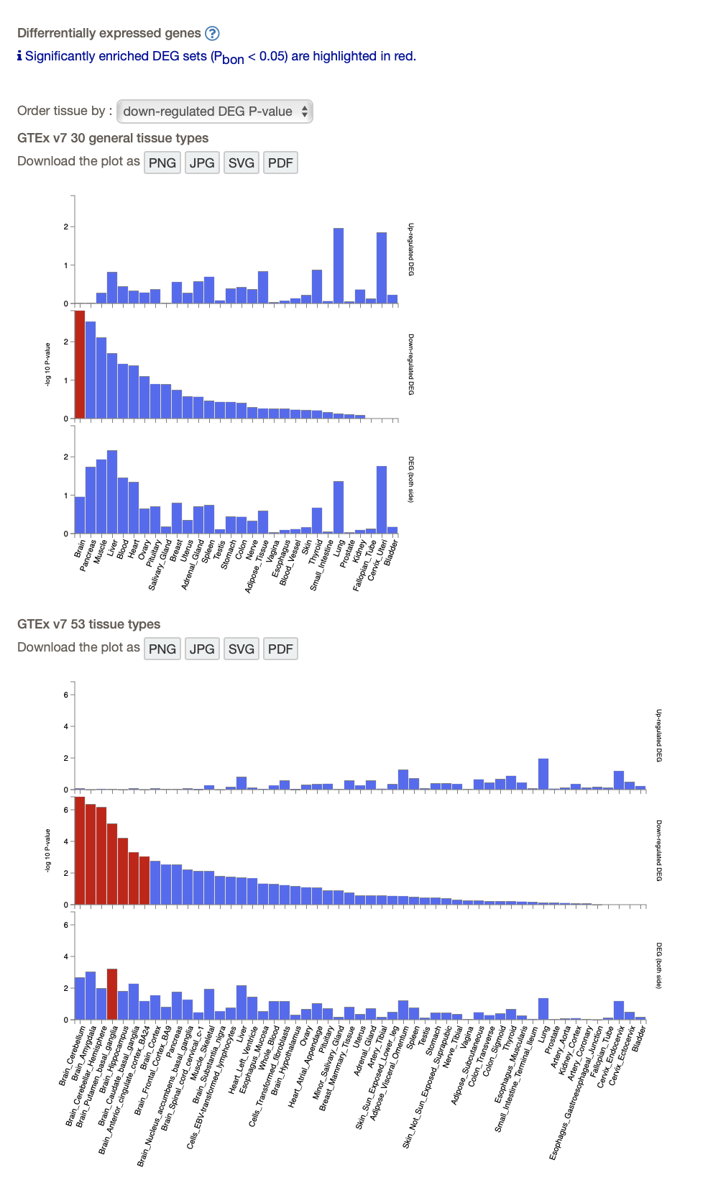
GENE2FUNC
Output (second part) Differential expression of genes across tissues
(Are the genes you supplied enriched for DE genes in particular tissues?)

Slide 58
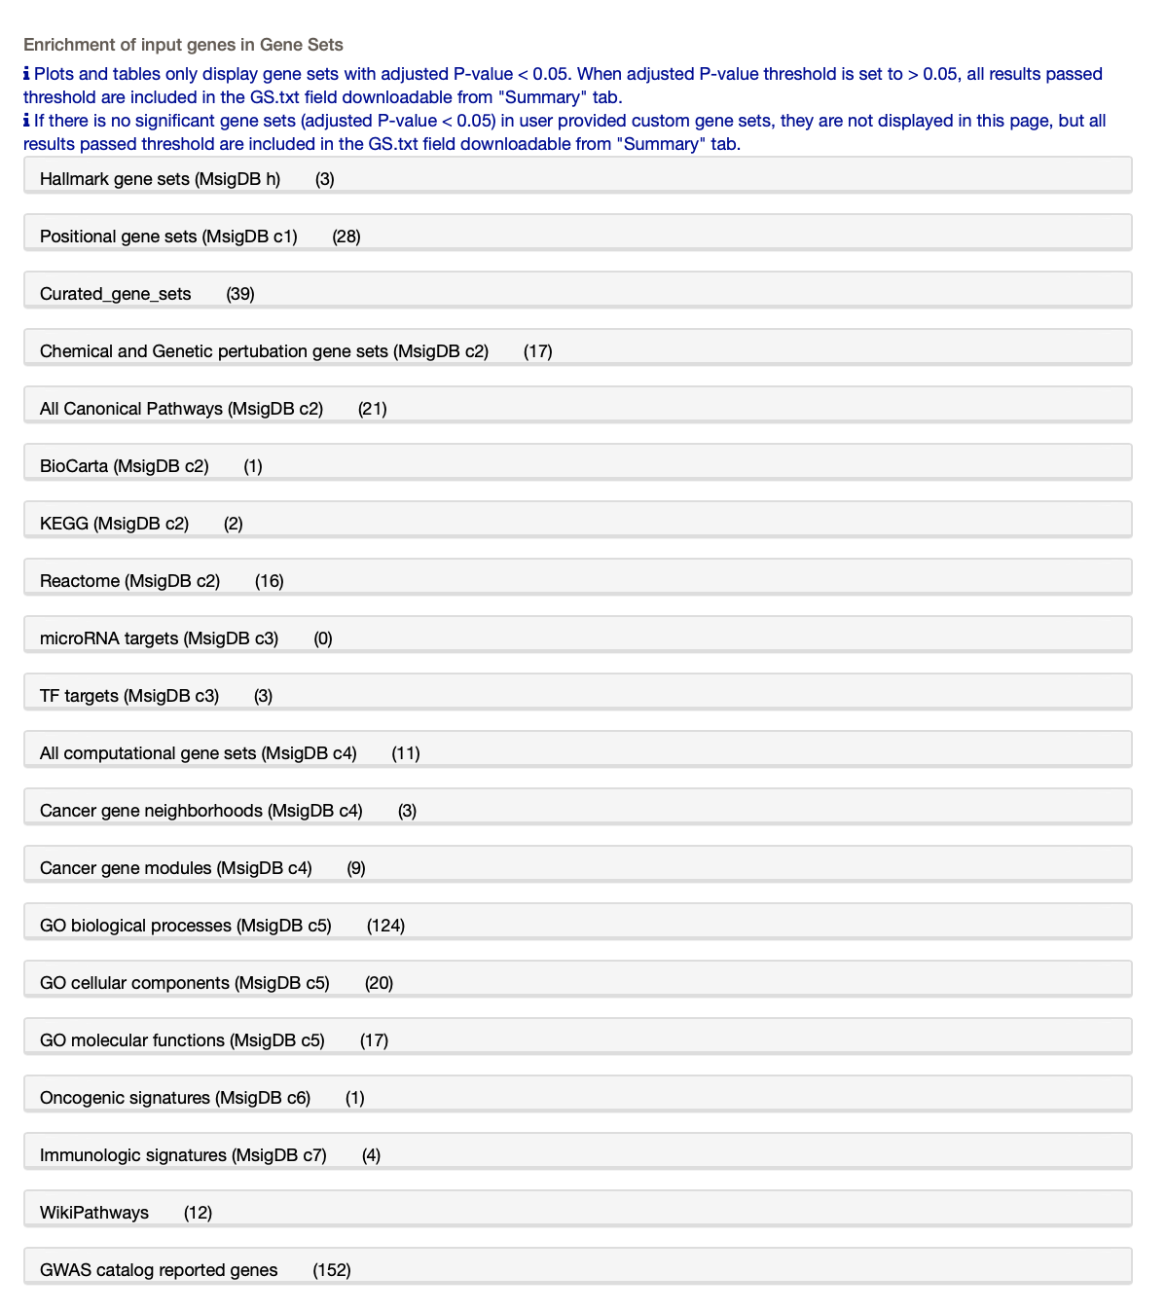
GENE2FUNC
Overrepresentation of your genes in pre-defined gene sets

Slide 59

GENE2FUNC
For example, choose “GO cellular components”
You can see exactly which genes in our list overlapped with these 20 GO terms, and how significant the overlap/enrichment is.

Slide 60

GENE2FUNC
Results are also viewable as a table.

Slide 61
One other FUMA function
Recall that FUMA uses GWAS summary statistics to perform gene-based testing in MAGMA.
MAGMA can integrate the gene-based p-values into a gene set testing framework.
Essentially this tests whether genes in a gene set are more strongly associated with the phenotype (compared to other genes).
Recall that this uses ALL genes, not just a set you chose.

Slide 62

MAGMA results
Gene sets defined by differential expression in various tissues.

Slide 63
GREAT
Genomic Regions Enrichment of Annotations
Publication http://bejerano.stanford.edu/papers/GREAT.pdf
Website http://great.stanford.edu/public/html/index.php
More documentation
https://great-help.atlassian.net/wiki/spaces/GREAT/overview?homepageId=655450

Slide 64

GREAT
Focus on “b”
Scenario: you want to know if some regions identified by your study are enriched for an annotation.
Arrows = gene transcription start sites
Black arrows = for genes without a specific annotation of interest
Green arrows = for genes without the annotation
Black lines = regulatory regions for gene without the annotation
Green arrows = regulatory regions for genes with the annotation
Calculate the fraction of the genome overlapping the green lines.
How many of your genomic regions overlap the green lines?
Perform a binomial test.

Slide 65

GREAT

Slide 66

GREAT
Select a species and provide input in BED format

Slide 67

GREAT
Example: plug in a list of 235 SNPs from a GWAS of height (http://great.stanford.edu/public/html/demo.php)

Slide 68

GREAT

Slide 69

GREAT
Output controls

Slide 70

GREAT
Example output for GO biological process

Slide 71

Other enrichment categories

Slide 72


GREAT
Mouse-based categories

